Slide 1

Science of AI and AI for Science
Daniel Khashabi
Notes:
Thank you for having me! It's an honor to be back at here and see so many new faces!

Slide 2
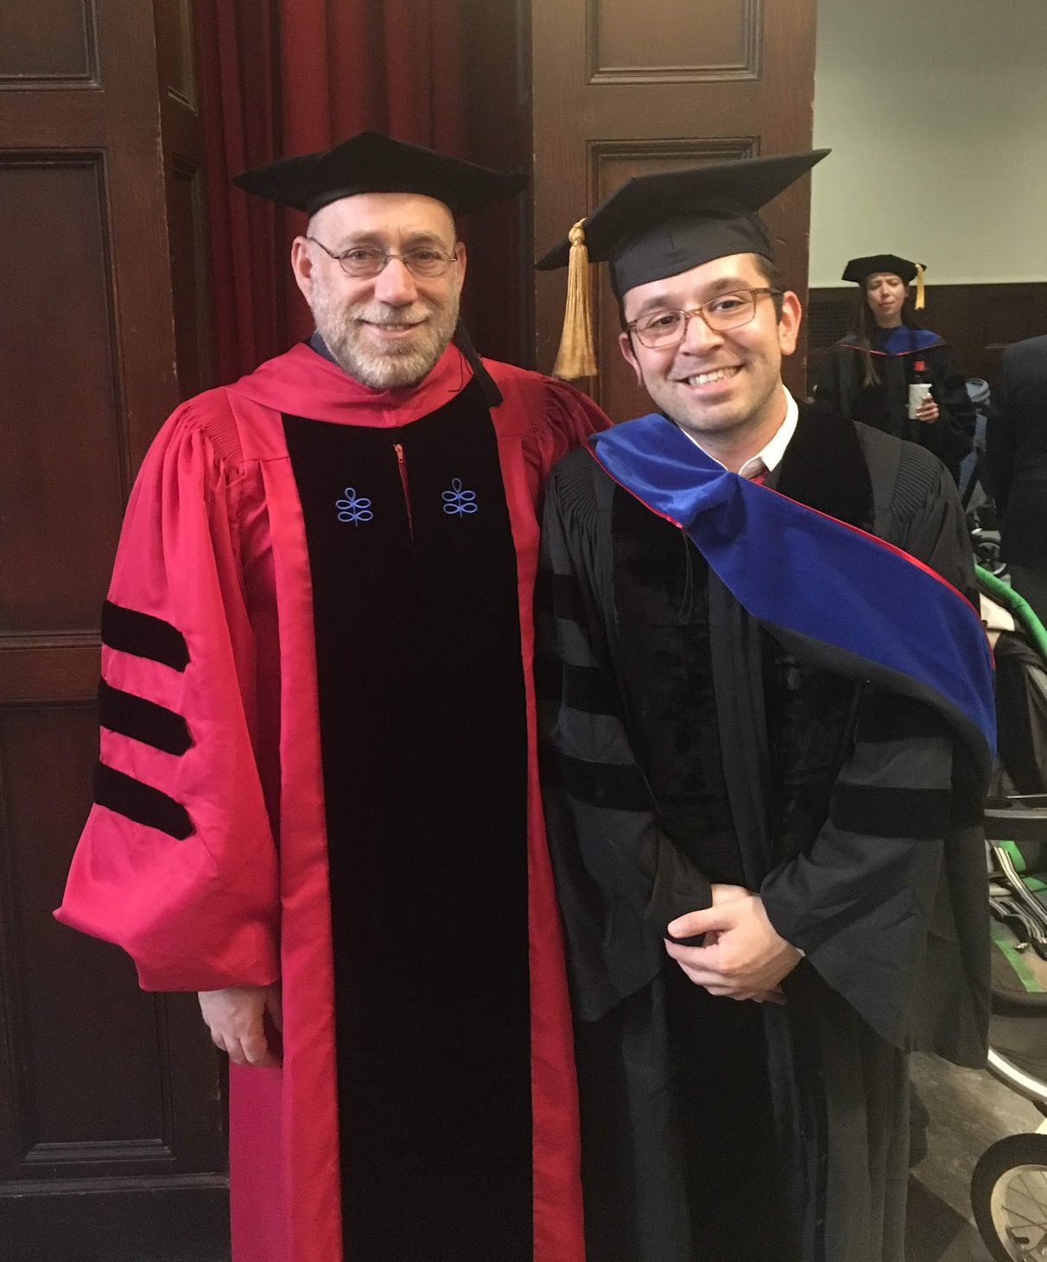
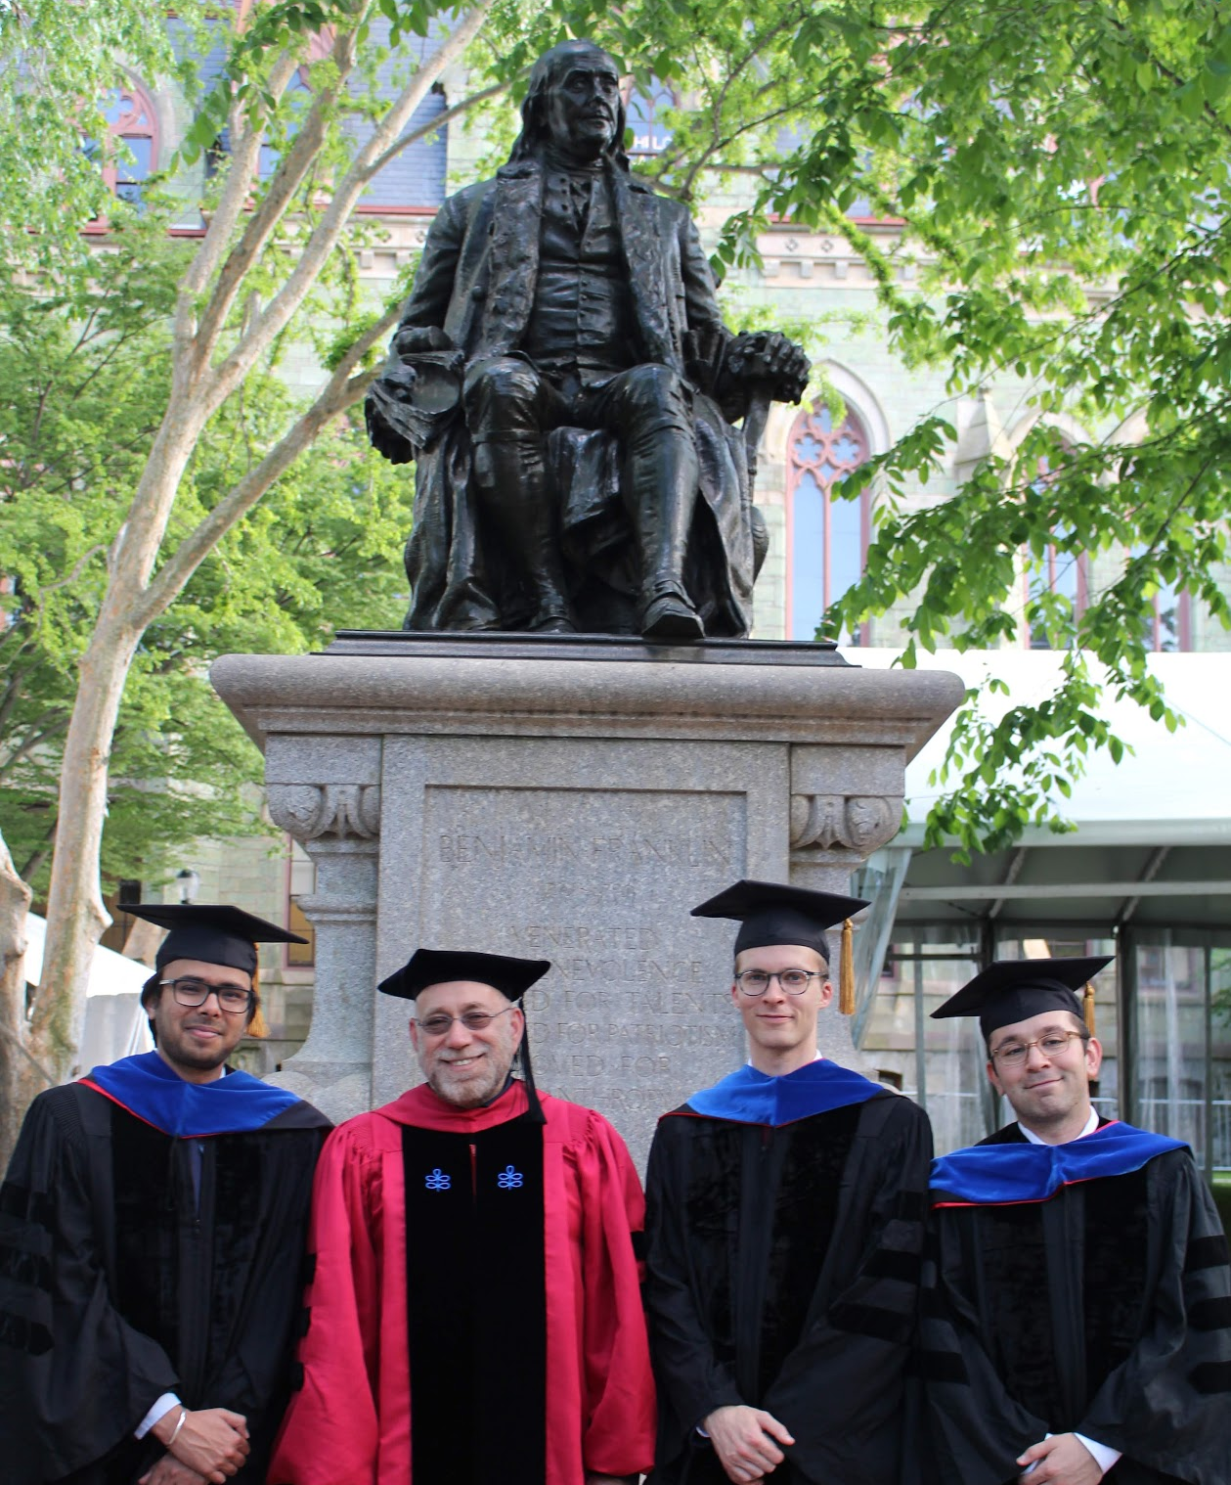
Go Quakers!!
Notes:
As … mentioned, I graduated from Penn in 2019 (6 years ago).
Here you can see me, Dan and Dr Ben Franklin, in old days.

Slide 3
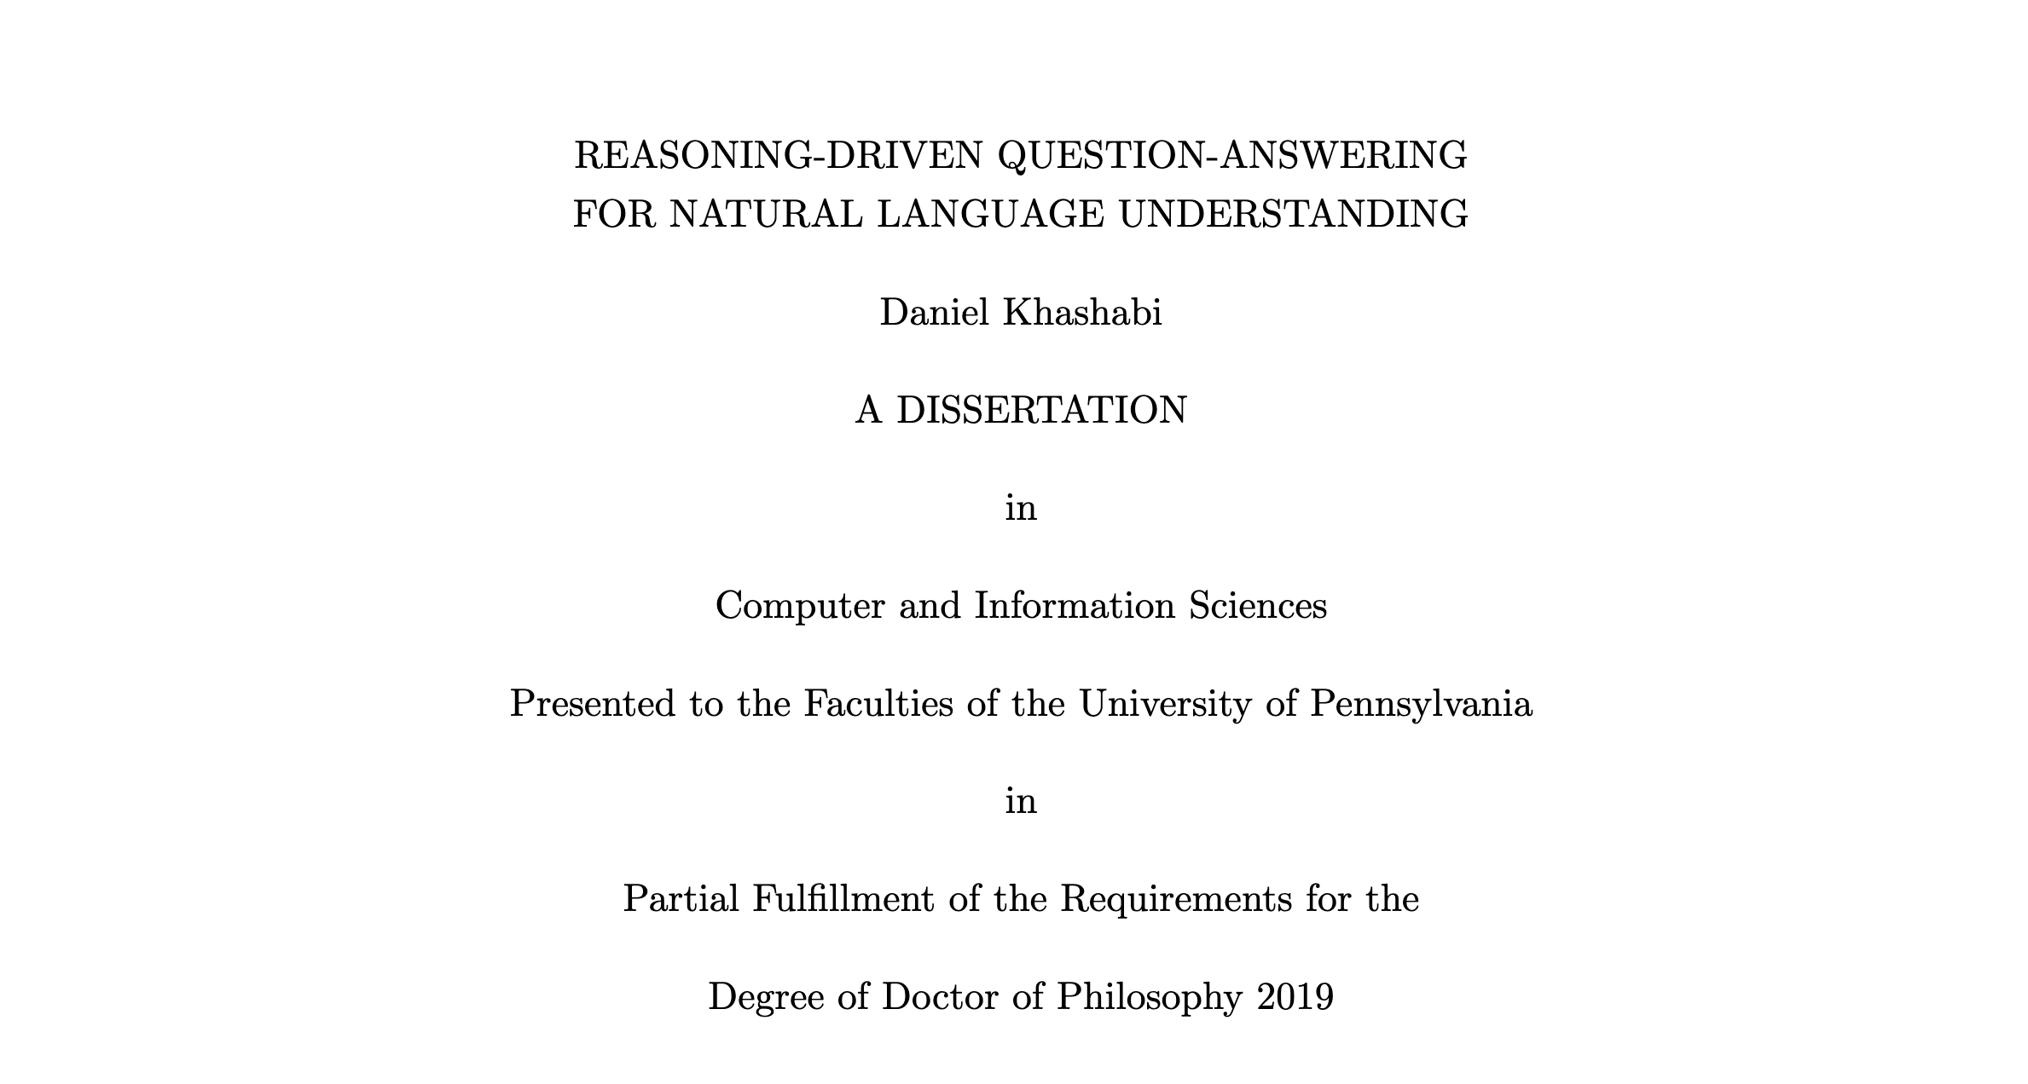
Notes:
Here is the cover page of my PhD thesis.
As you can see from the title, the majority of my PhD was about reasoning (a topic that is extremely hot these days).
And we studied in the context of question answering

Slide 4
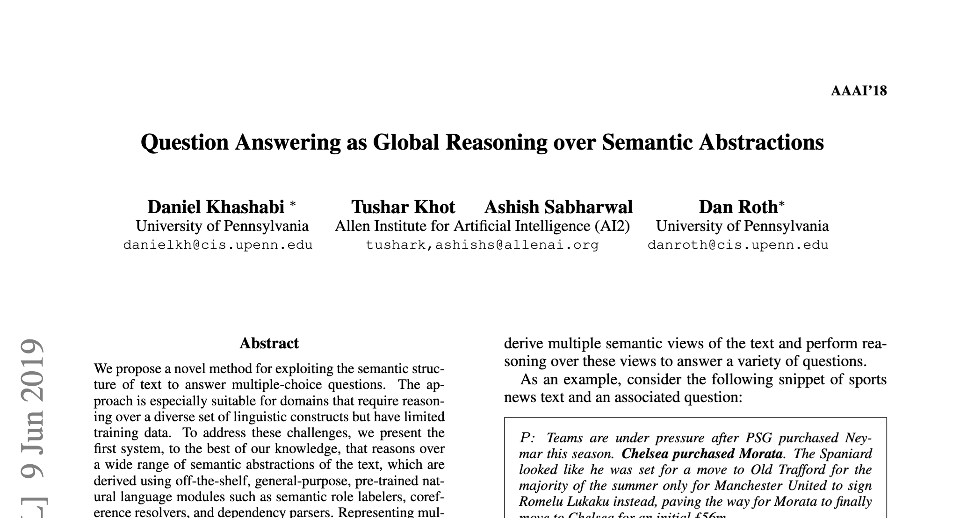
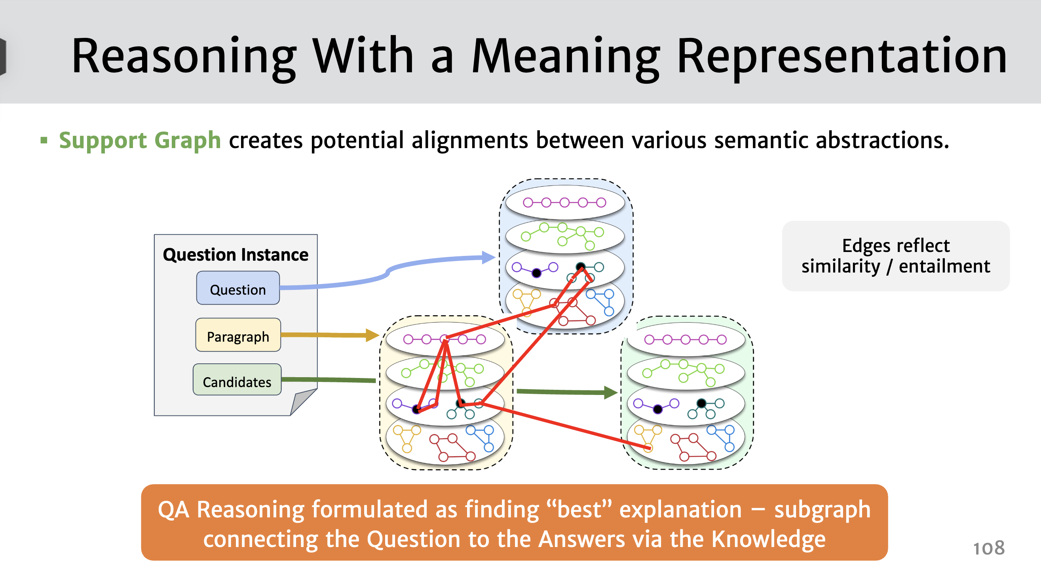
Inference-time reasoning!!!
Besides “reasoning”, another motivation was ”general-purposeness”.
We just didn’t have the right representation.
Notes:
Essentially our hypothesis, which has held true, was that you need these high-level operations that bridge different nuggets of information in order to solve problem – basically inference-time reasoning.
Another important motivation was that, we want to build genera-purpose models that work on variety of settings, not just specialized to a particular dataset.
It was evident that “reasoning” and “generality” are necessary ingredient. We just didn’t use the right …

Slide 5
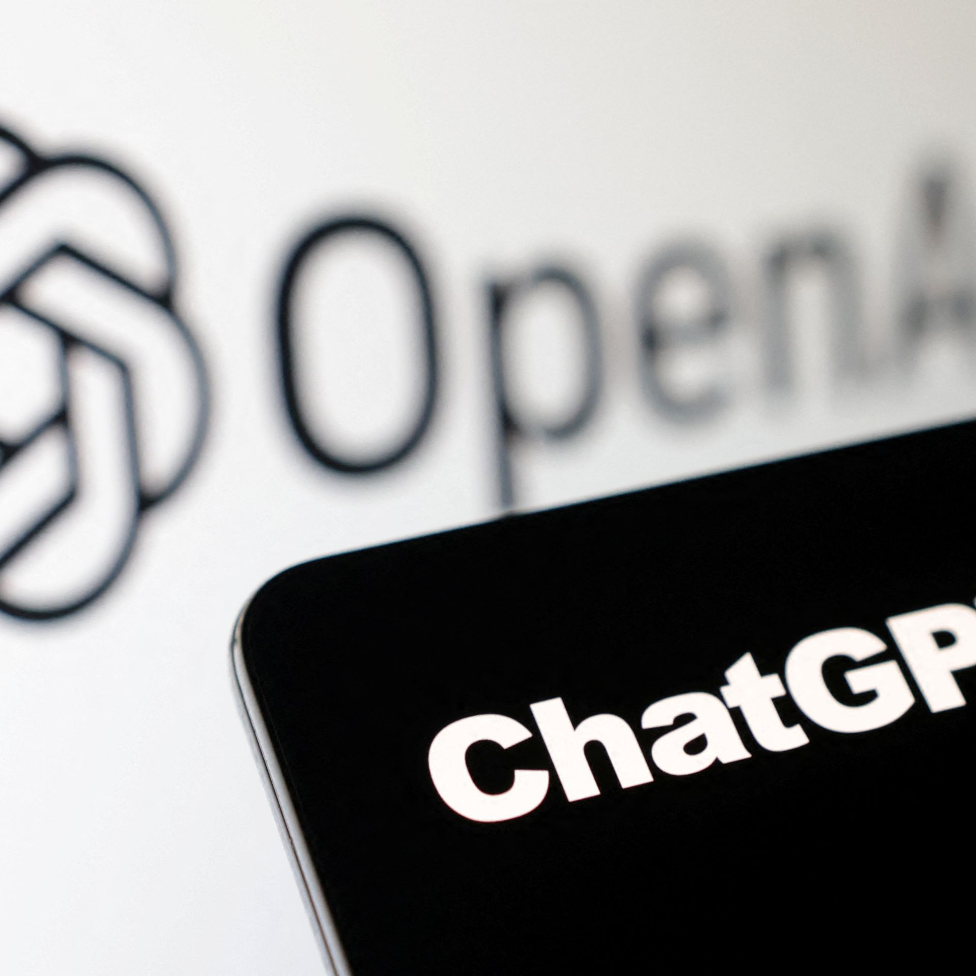



The progress we dreamed of
Language models that are remarkably capable at solving many important NLP benchmarks.
Notes:
Fast forward a couple of years, we are at a point where we dreamed of years ago.
Language models are general-purpose and they are remarkably capable at many important NLP tasks.

Slide 6
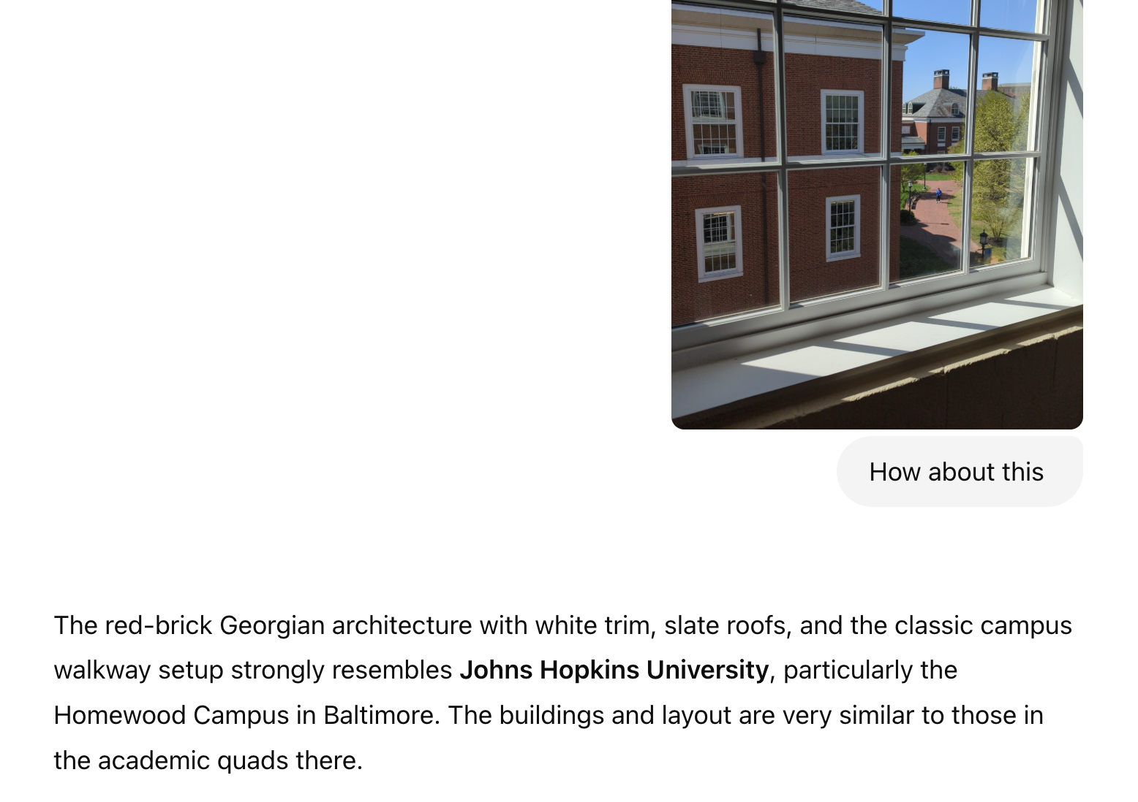
The progress we dreamed of
Notes:
This is a conversation with ChatGPT model from last week where I show it a partial view from my office, and it correctly guess where the picture is showing.
Just remarkable.

Slide 7
However, LLMs remain brittle …

Slide 8
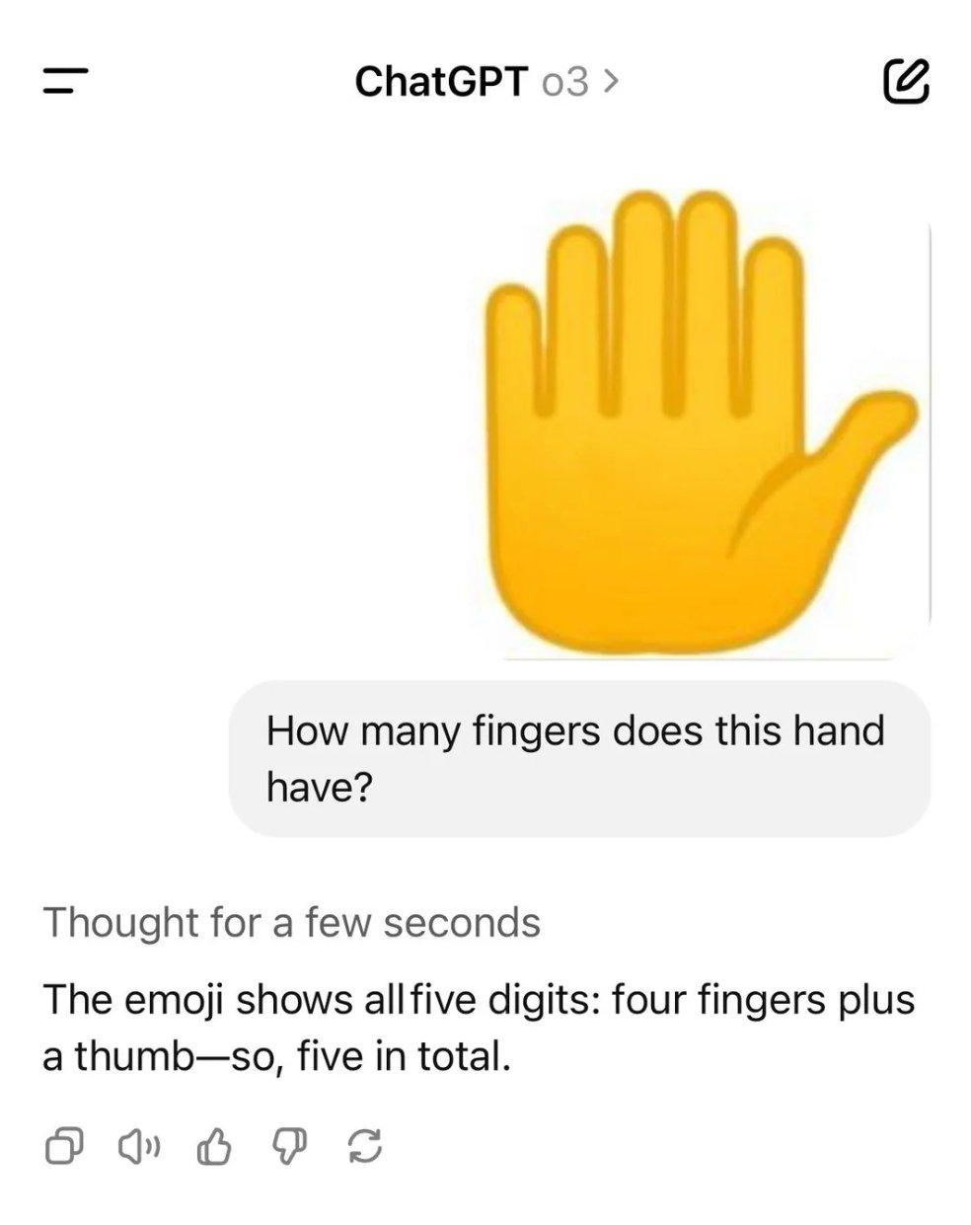
https://www.reddit.com/r/OpenAI

Slide 9
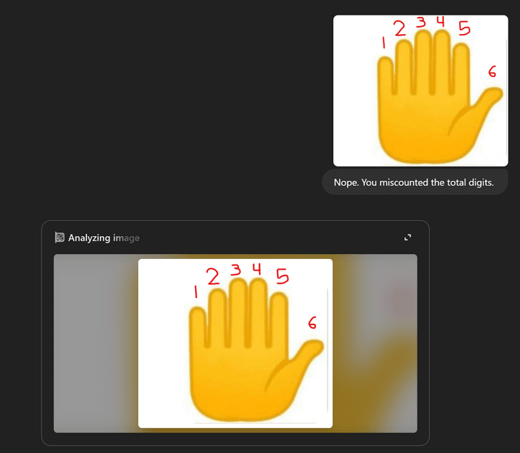
https://www.reddit.com/r/OpenAI

Slide 10
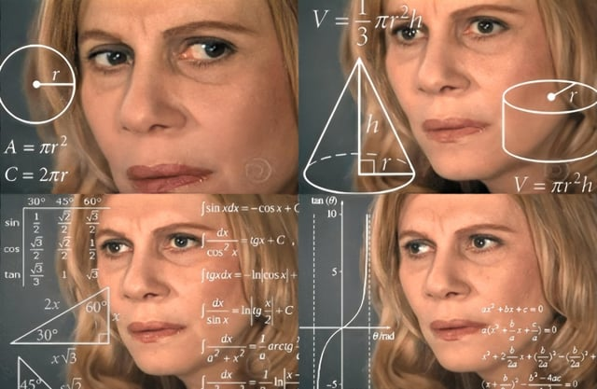

Slide 11
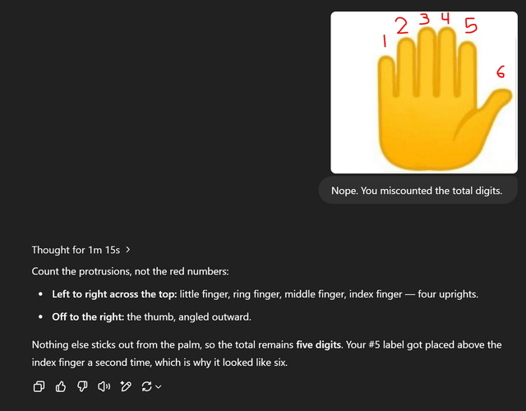
https://www.reddit.com/r/OpenAI

Slide 12
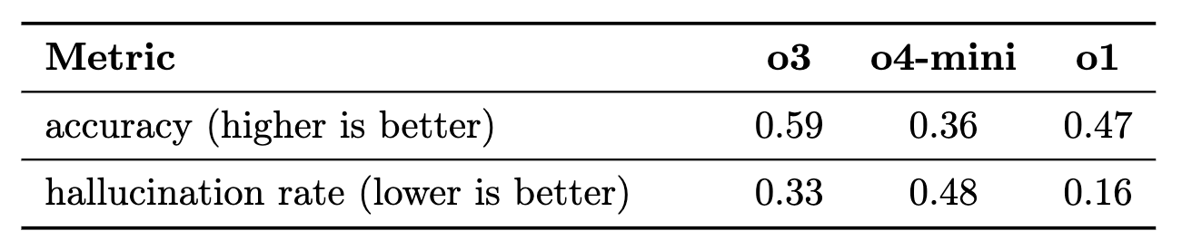
LLMs remain to be brittle
The new models (o3 and o4-mini) hallucinated more than the earlier o1 models.
OpenAI: o3 and o4-mini model card

Slide 13
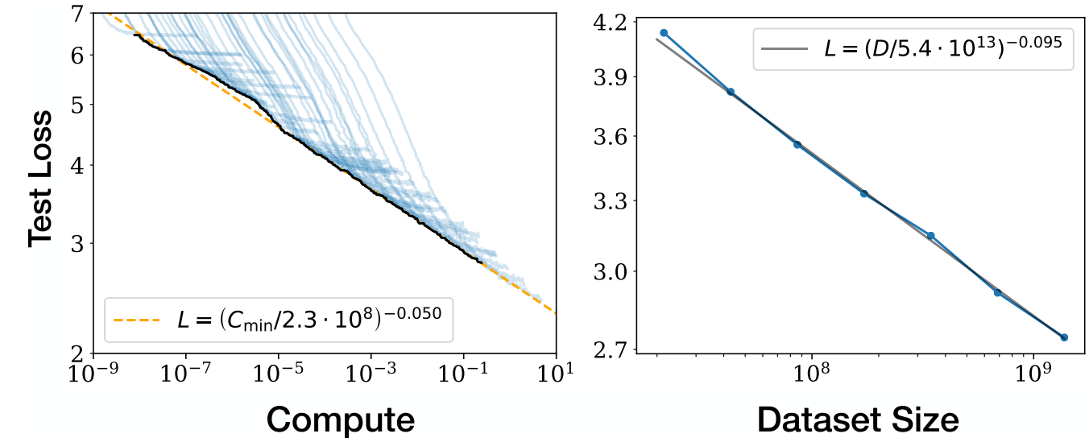
Will “scaling” solve LLM brittleness?
Linear
Kaplan et al. 2020; among others
Exponential
Exponential
Diminishing returns w/ scaling (compute, data, human supervision.)
Notes:
It’s interesting to wondering why scaling hasn’t solved the LLM brittleness. After all, from scaling laws we know that more is better.
every time that we increase model sizes and their data, their error goes down.
However, if you look closer, the x-axis (the resources) is exponential, while the y-axis (the gains) is linear.
In other words, a linear reduction in errors requires exponential increase in resources.
Or: there is a diminishing returns with scaling.
As a results, LMs will remain brittle at least for the coming years.

Slide 14
LMs will remain brittle
We should face this reality.
It’s imperative to understand the scope of their brittleness.
What are the underlying reasons? How can we mitigate them.
There is so much to ”scaling” LLM beyond just scaling.
What are the application frontiers that are near feasible?
Science of AI
AI for Science
Notes:
Generalist chatbots will remain brittle and hallucinatory (unless something miraculous changes in how build AI)
That’s just a reality that, in my opinion, we need to accept and live with.
Instead, it’s more helpful to think about how to “contain” LM brittleness (rather than solving it entirely, which might be impossible)
…

Slide 15
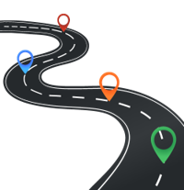
Roadmap
Science of AI
Rethinking data.
Few new challenge problems
x
AI for Science
Notes:
Specifically, today I am going to discuss two topics.

Slide 16
AI Data is the “new electricity”
Kaplan et al. 2020; among others
More data (and compute) leads to better models.

Slide 17
Limits of scaling “laws”
Kaplan et al. 2020; among others
Which data? How is it distributed?
Notes:
But the so-called scaling laws are hiding so many nuances about data.
How is it distributed? What is it about?
These are basically aggregate statistics that show the overall trends, but there is so much more to our data that is now show by these trends.

Slide 18
Limits of scaling “laws”
Kaplan et al. 2020; among others
There are various nuances about data that are not explained any ”laws” and remain poorly understood.

Slide 19
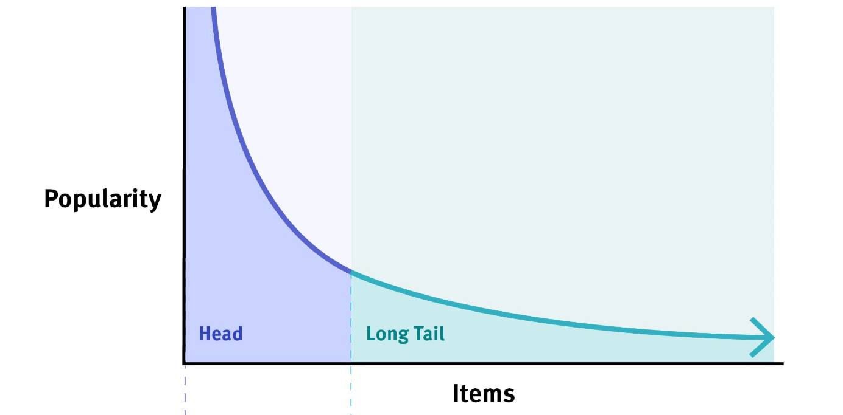
Beyond blackbox laws: knowledge distribution
Knowledge is not uniformly distributed.

Slide 20
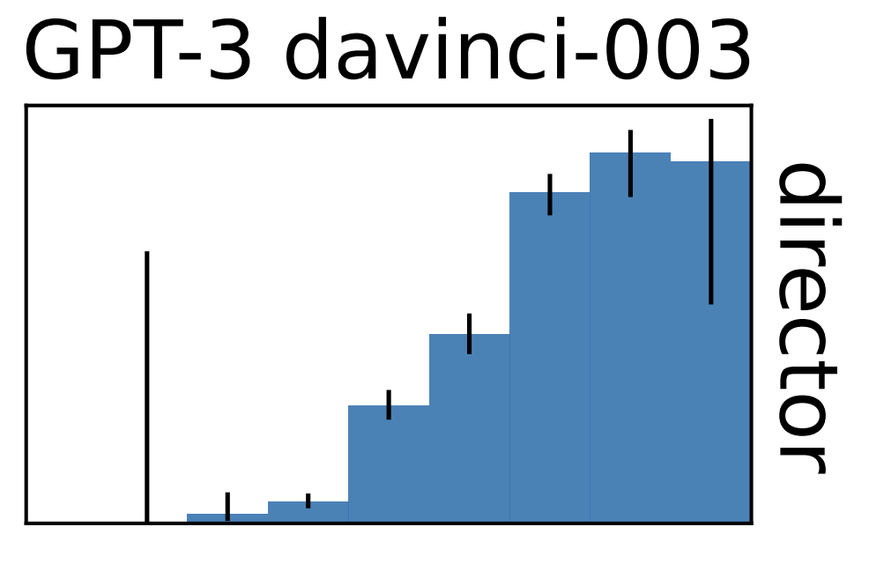
Beyond blackbox laws: knowledge distribution
Knowledge is not uniformly distributed.
frequent (head)
infrequent (tail)
Factual accuracy of LLMs is positively correlated with ”popularity” of the input prompts.
accuracy
query log-popularity
When Not to Trust Language Models: Investigating Effectiveness of Parametric and Non-Parametric Memories, (Mallen et al. ACL 2023)

Slide 21
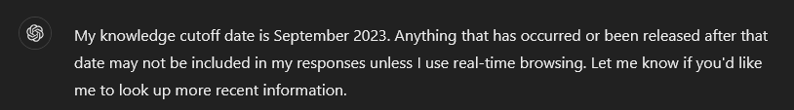
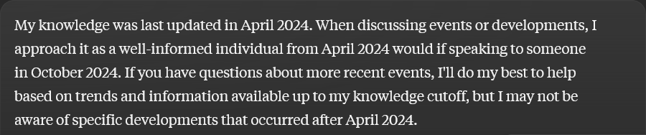
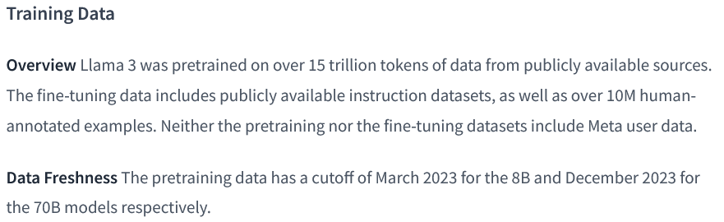
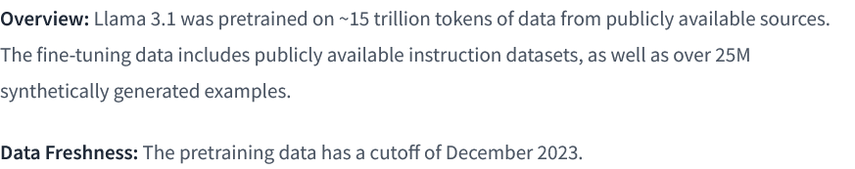
Beyond blackbox laws: Knowledge Cutoffs
Notes:
If you've experimented with LLM, you've likely encountered descriptions similar to those presented here.
For competitive reasons, many LLM providers choose to keep their pre-training datasets confidential, opting instead to disclose a single knowledge cut-off date.

Slide 22
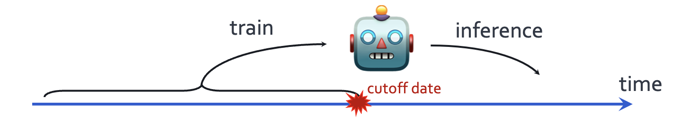
Temporal misalignment: LLMs stale over time
LLM quality degrade after their cut off date.
Time Waits for No One! Analysis and Challenges of Temporal Misalignment., (Luu et al. NAACL 2022)
Mind the Gap: Assessing Temporal Generalization in Neural Language Models, (Lazaridou et al. NeurIPS 2021)
Notes:
The first issues that I will discuss is about time.
When designing a language model, we train it on past data that is available on the web before a fixed cut off date, but we evaluate it on the examples of future.
Now it is well-understood that their performance degrades, the longer we move post the cut off date.
What about its quality before the cut off date?
Is their knowledge before the cutoff date consistently good?

Slide 23
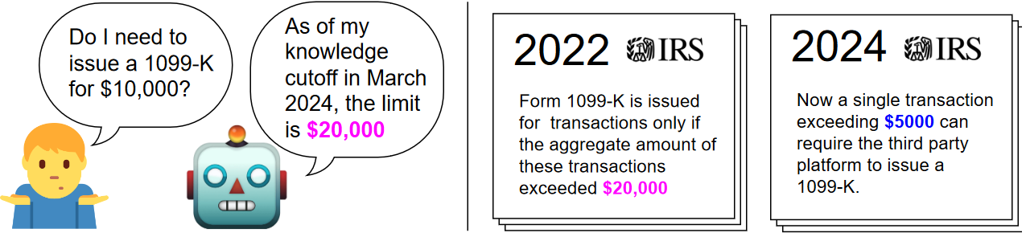
How reliable is LLM knowledge before the cutoff?
What users want:
Always use the latest version of facts, if there is any update.
Notes:
- … .if a model is trained on various resources like Wikipedia or PubMed, do all these resources share the same reported cut-off date?
This important for users who need up-to-date information from their models. Imagine an LLM user querying a model about tax documents. Even if the model's reported cut-off is 2024, if its knowledge of those tax documents is aligned with an earlier date, say 2022, the user might receive incorrect information.
To address these questions, we define the concept of an "effective cut-off" for an LLM ….

Slide 24



Dated Data: Tracing Knowledge Cutoffs in Large Language Models
Jeffrey Cheng, Marc Marone, Orion Weller,
Dawn Lawrie, Daniel Khashabi, Benjamin Van Durme
🥇 COLM 2024 Outstanding paper award! 🥇

Slide 25
LLM reliability before the cutoff
How should we quantify this?
Notes:
- … .if a model is trained on various resources like Wikipedia or PubMed, do all these resources share the same reported cut-off date?
This important for users who need up-to-date information from their models. Imagine an LLM user querying a model about tax documents. Even if the model's reported cut-off is 2024, if its knowledge of those tax documents is aligned with an earlier date, say 2022, the user might receive incorrect information.
To address these questions, we define the concept of an "effective cut-off" for an LLM ….

Slide 26

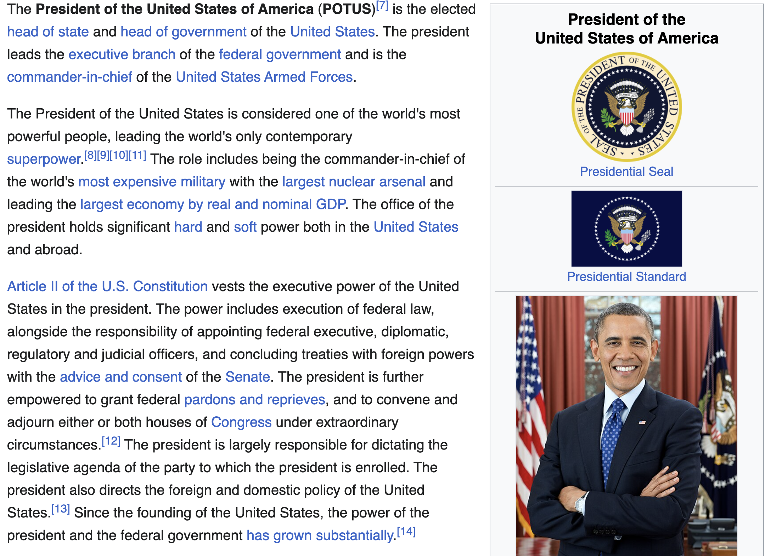
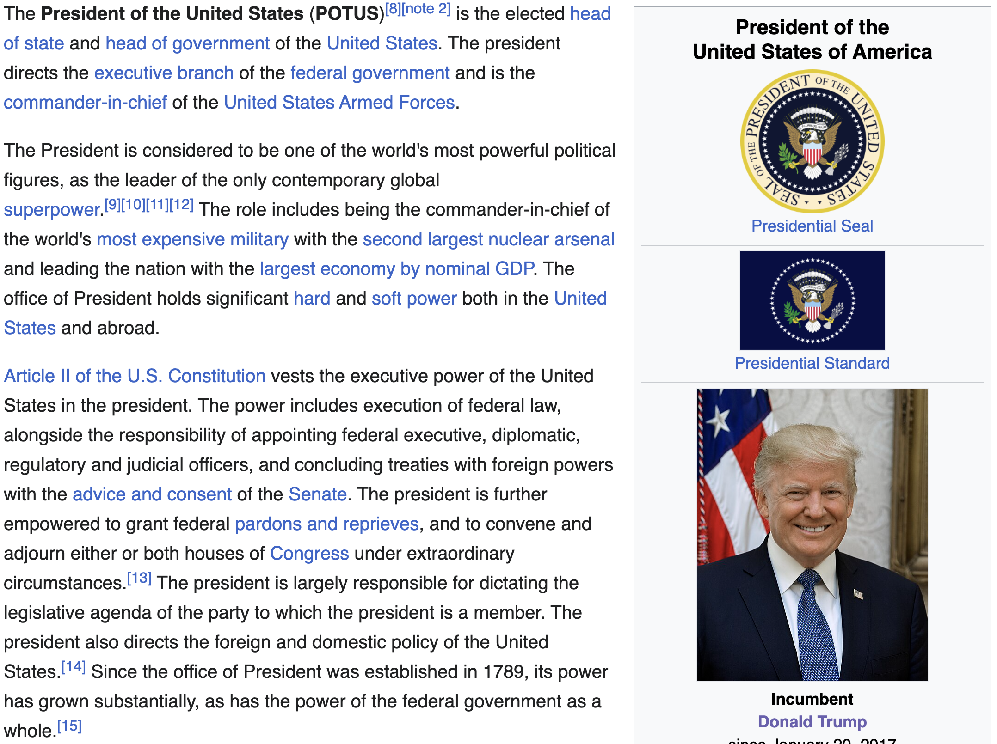
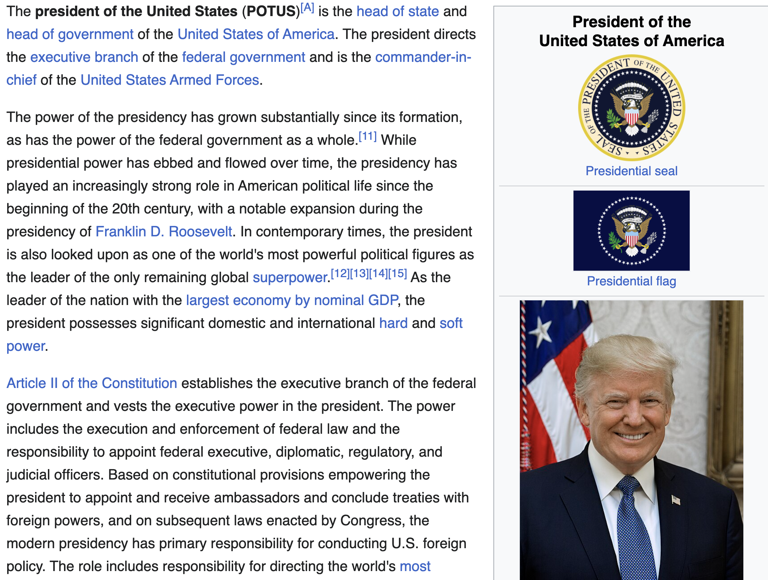
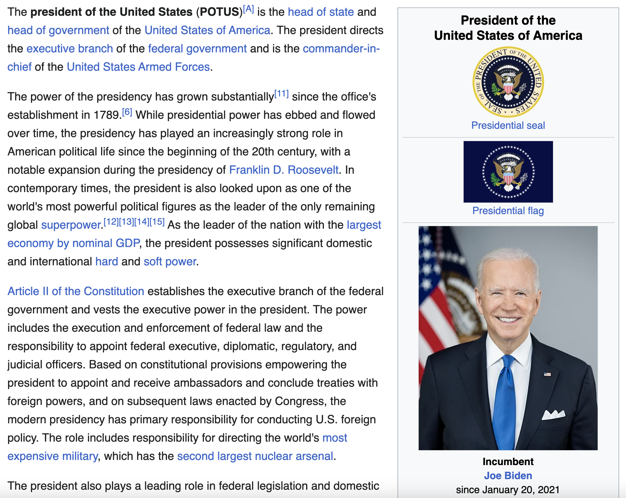
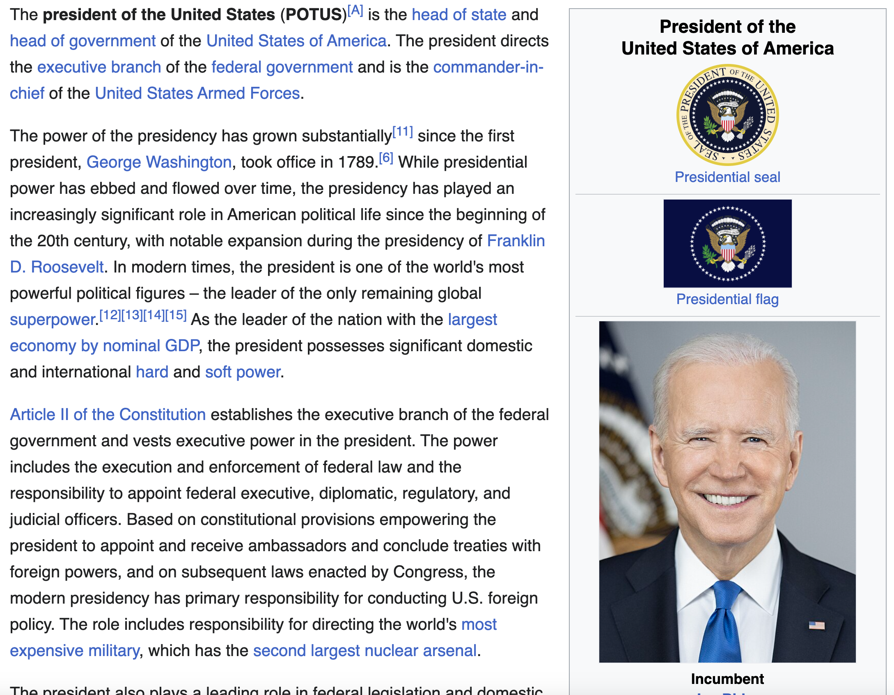
How do we measure knowledge over time?
WIKISPAN:
Collect 5000 most edited topics
Scrape monthly versions from April 2016 to April 2023
2016
2018
2020
2022
2023
Cheng et al. Dated Data: Tracing Knowledge Cutoffs in Large Language Models., COLM 2024
Notes:
To investigate this, we estimate effective cut-offs by creating time-spanning datasets and measuring perplexity across the data, identifying effective cut-offs from these measurements. Importantly, our method for estimating effective cut-offs does not require access to the model's pre-trained data, although we later verify our results using ground truth data.
We constructed a dataset from Wikipedia, we collected the 5,000 most edited topics by edit number and scraped versions of these documents monthly from April 2016 to April 2023. This resulted in a total of 5,000 topics over 84 months, forming the WikiSpan dataset. A document in WikiSpan is simply a version of a Wikipedia topic at a specific time.
I’ll also note that …

Slide 27
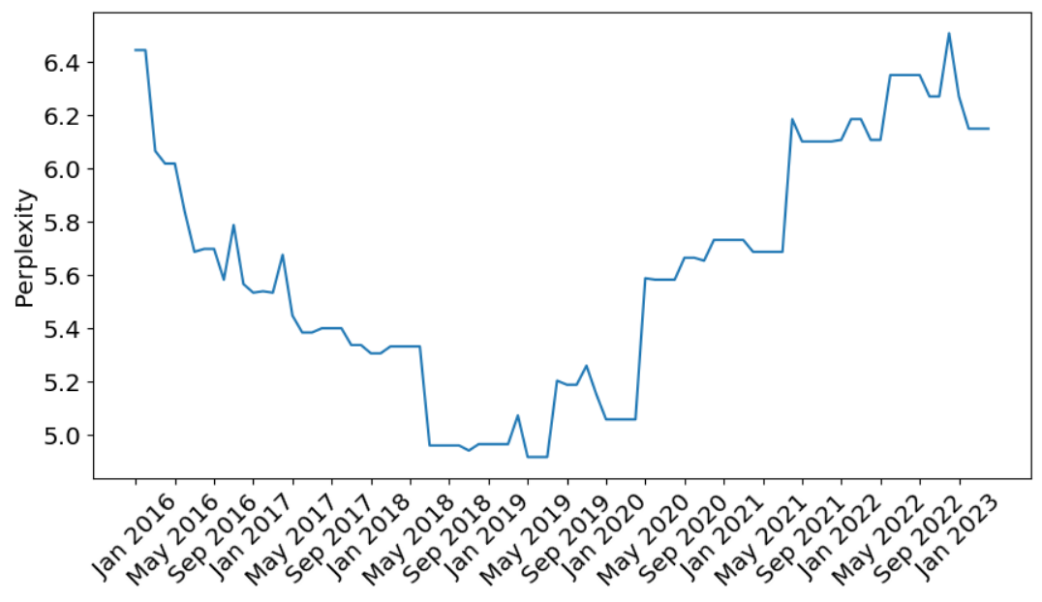
Extract PPL over time with WIKISPAN
WIKISPAN documents: version of Wikipedia topic t at time m
Measure perplexity of first 512 tokens of each document, across all topics and months
Perform 0-1 normalization over entire time-span
Perplexity of the Wikipedia document “Liverpool'' under Pythia-7b. Each point is the perplexity of the document at that time.
Cheng et al. Dated Data: Tracing Knowledge Cutoffs in Large Language Models., COLM 2024
Notes:
A document in WikiSpan is simply a version of a Wikipedia topic T at time M.
For each topic, we measured the perplexity of the first 512 tokens across all months, allowing us to generate perplexity curves.
For example, the perplexity of the Wikipedia topic "Liverpool" under the Pythia model is shown here, with each point representing the perplexity of a document at a specific date.

Slide 28
Expectation: which trend would you expect?
(relative) perplexity
(relative) perplexity
claimed cutoff
claimed cutoff
time
time
(relative) perplexity
(relative) perplexity
claimed cutoff
claimed cutoff
time
time

Slide 29
PPL of RedPejamas over time
RedPajamas (Together Computer)
“We use the Wikipedia dataset available on Huggingface, which is based on the Wikipedia dump from 2023-03-20 and contains text in 20 different languages. The dataset comes in preprocessed format, so that hyperlinks, comments and other formatting boilerplate has been removed.”
Cheng et al. Dated Data: Tracing Knowledge Cutoffs in Large Language Models., COLM 2024
Notes:
Now, for some results: We first consider models trained on C4. The first model is RedPajamas, which uses w Wikipedia dump from March 2023 dump, which we take as the reported cut-off date.

Slide 30
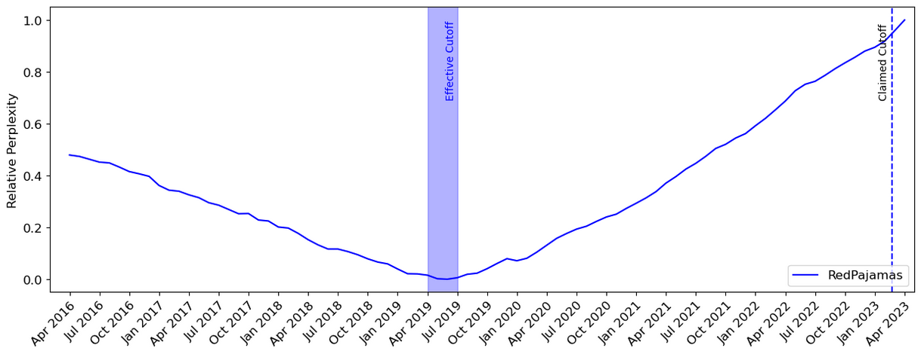
PPL of RedPejamas over time
claimed cutoff
Cheng et al. Dated Data: Tracing Knowledge Cutoffs in Large Language Models., COLM 2024
Notes:
Here is the results: …
Our results show that whilethe effective cut-off is much earlier than the claimed cut-off dated, around mid-2019.

Slide 31
“Effective Cutoff”
The effective cutoff of an LLM with respect to a resource is the date that matches the LLM’s best knowledge of that resource.
Cheng et al. Dated Data: Tracing Knowledge Cutoffs in Large Language Models., COLM 2024
Notes:
Finally, we identify the effective cut-offs of these models as the argument of the relative perplexity curves, indicated by the red line.

Slide 32
“Effective Cutoff” in other models
Cheng et al. Dated Data: Tracing Knowledge Cutoffs in Large Language Models., COLM 2024
Notes:
Now, for some results: We first consider models trained on C4 in addition to other Common Crawl dumps. The first model is RedPajamas, which also trains on a March 2023 dump, taken as the reported cut-off date. Our results show that while the reported cut-off is marked by a blue dotted line, the effective cut-off is much earlier, around mid-2019.
Next, we examine LLaMA, which uses a Wikipedia dump from June 2022, and find a significant 5-year gap between the effective and reported cut-offs. Similarly, for another model using a March 2023 Wikipedia dump, we observe a discrepancy between effective and reported cut-offs.

Slide 33
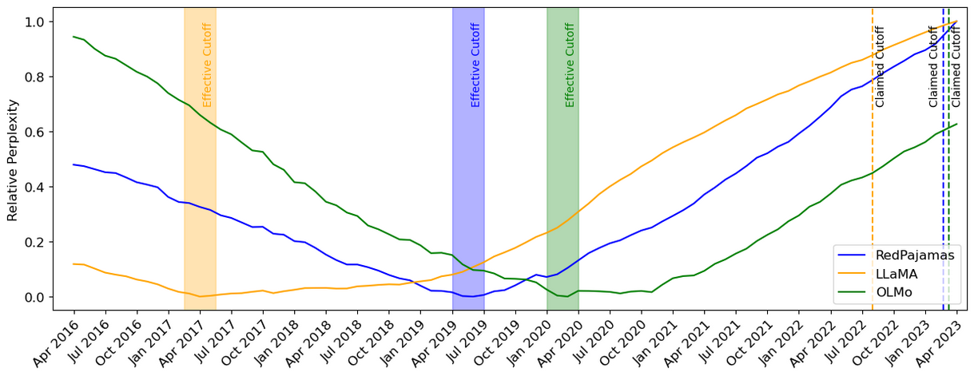
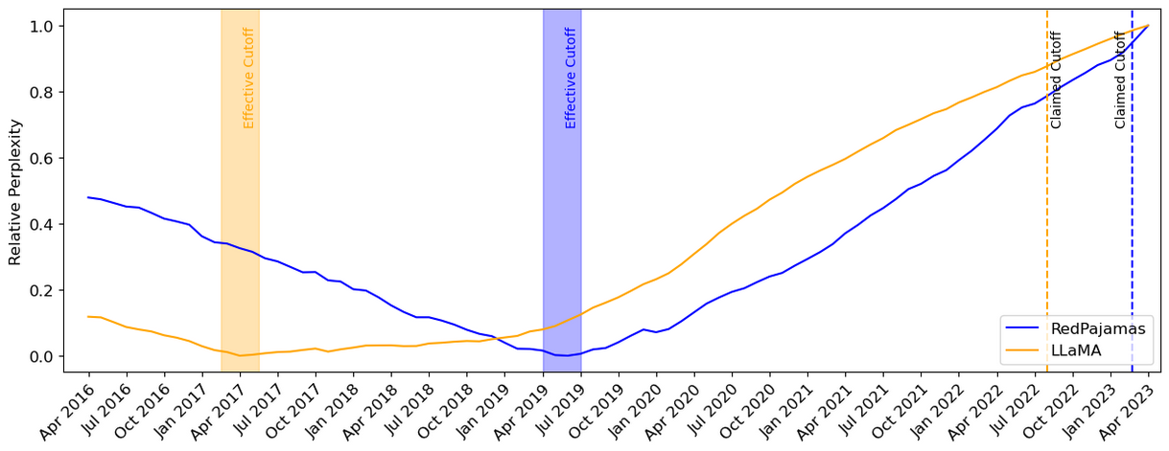
“Effective Cutoff” in other models
Cheng et al. Dated Data: Tracing Knowledge Cutoffs in Large Language Models., COLM 2024
Notes:
Now, for some results: We first consider models trained on C4 in addition to other Common Crawl dumps. The first model is RedPajamas, which also trains on a March 2023 dump, taken as the reported cut-off date. Our results show that while the reported cut-off is marked by a blue dotted line, the effective cut-off is much earlier, around mid-2019.
Next, we examine LLaMA, which uses a Wikipedia dump from June 2022, and find a significant 5-year gap between the effective and reported cut-offs. Similarly, for another model using a March 2023 Wikipedia dump, we observe a discrepancy between effective and reported cut-offs.

Slide 34
“Effective Cutoff” in other models
Cheng et al. Dated Data: Tracing Knowledge Cutoffs in Large Language Models., COLM 2024
Notes:
Now, for some results: We first consider models trained on C4 in addition to other Common Crawl dumps. The first model is RedPajamas, which also trains on a March 2023 dump, taken as the reported cut-off date. Our results show that while the reported cut-off is marked by a blue dotted line, the effective cut-off is much earlier, around mid-2019.
Next, we examine LLaMA, which uses a Wikipedia dump from June 2022, and find a significant 5-year gap between the effective and reported cut-offs. Similarly, for another model using a March 2023 Wikipedia dump, we observe a discrepancy between effective and reported cut-offs.

Slide 35
Why such discrepancies exist between effective vs. reported cutoffs?
Notes:
This leads us to our central question: Why do discrepancies between effective and reported cut-offs exist, and why do they only occur in some language models?
To answer this, we conducted a thorough investigation into available pre-training datasets, indexing over 4 trillion tokens.

Slide 36
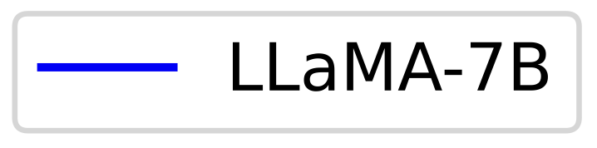
(lower is better)
claimed cutoff
Cheng et al. Dated Data: Tracing Knowledge Cutoffs in Large Language Models., COLM 2024
Notes:
One ideal expectation here is to have a flat line. Basically, all the past data should be equally known to the model.
Another acceptable hypothesis is that the model should be better at recent data (just before cutoff), compared to the older data.

Slide 37
Pre-training data contain lots of old/stale data
The distribution of older/stale [Wikipedia] data in C4 which is popularly used as part of pre-training.
(lower is better)
claimed cutoff
Cheng et al. Dated Data: Tracing Knowledge Cutoffs in Large Language Models., COLM 2024
Notes:
Non-trivial amount of old/stale data inside pre-training data.
Depending on which pre-training corpus you look at, you may see more older than data than newer ones.
Why is this happening?
Part of the issue is that, dealing with pre-training data is challenging. It’s hard to balance for older and newer data.
Part of the issue is the urge to scale. We need more data to scale. It’s better to have more data, then less data

Slide 38
Summary thus far
x
Effective cutoffs of recent LLMs are years earlier than reported cutoff
CommonCrawl dumps include older versions of resources
Not explained by scaling ”laws”!
There are exceptions:
Effective cutoffs of Pile-derived models matches their reported cutoff
Small amount of CommonCrawl used (< 25% of one CC dump)
Open question: what is the implication for applications?
x
x
Notes:
This is in partially because the relative size of CommonCrawl data in the Pile is much less compared to modern LLM training corpuses. The Pile included tiny fractions of several dumps while many LLMs now use from 5 – 20 full dumps.
The two factors compound on one another. The use of CommonCrawl dumps results in older versions of resources getting included in pretraining data, and deduplication pipelines are empirically fail to detect these older versions
Thus, the effective cutoffs of modern LLMs often differ from their reported cutoffs by a period of many years

Slide 39
Long-tail of problems: There are many infrequent concepts/problems
Notes:
The other issue that we do not see in the scaling laws trends is the long-tail phenomenon.
- There are many things (concepts, languages, ideas) that are infrequent in the world and in the pretraining data of LLMs.
Let's see a concrete example of this.

Slide 40
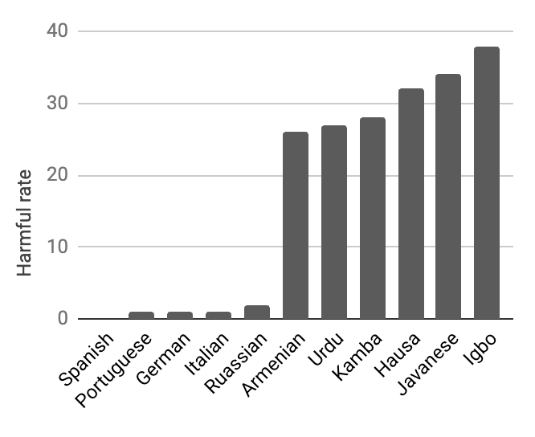
Example: The long-tail of languages
English
Swahili
Italian
Chinese
high-resource
(head)
low-resource
(tail)
Tokens of pretraining data by language in mC4 (Xue+ 2024)
The Language Barrier: Dissecting Safety Challenges of LLMs in Multilingual Context. (Shen et al. ACL 2024)

Slide 41
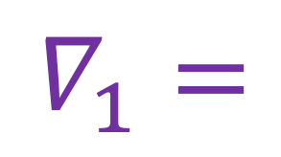
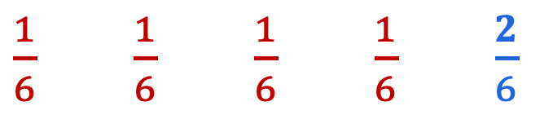



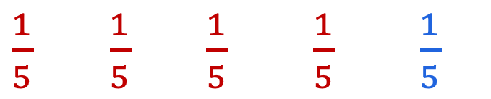
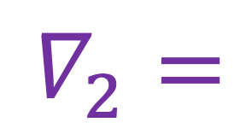
How should we [pre-]train on imbalanced data?
Scalarization (sample uniformly; upweight small domain)
Sampling (oversample small domain; average uniformly)
4x larger
$$∇_{1}=$$
[$∇$, $∇$, $∇$, $∇$, $∇$]
$$∇_{2}=$$
[$∇$, $∇$, $∇$, $∇$, $∇$]
$×$ $×$ $×$ $×$ $×$
$×$ $×$ $×$ $×$ $×$
$\frac{1}{6}$ $\frac{1}{6}$ $\frac{1}{6}$ $\frac{1}{6}$ $\frac{2}{6}$
$\frac{1}{5}$ $\frac{1}{5}$ $\frac{1}{5}$ $\frac{1}{5}$ $\frac{1}{5}$

Slide 42

Upsample or Upweight? Balanced Training on Heavily Imbalanced Datasets
Tianjian Li, Haoran Xu, Weiting Tan,
Kenton Murray and Daniel Khashabi.
To appear in NAACL ‘25 (next week!!)

Slide 43
Training on a collection of “domains”
Consider training a model on a collection domains:
…
The whole data
A batch of data
Notes:
Let’s make the setup more formal.
Let’s say we want to train a model on a set of K domains: D_1, D_2, ….
As I am showing here visually, these domains might come in different sizes.
Define a procedure for sampling batches of data.
We first define a distribution for sampling from our domains based on their sizes, but scaled according to a temperature parameter.

Slide 44
Training on a collection of “domains”
uniform sampling from the whole data.
oversamples smaller domains.
samples equal number from each domain.
…

Slide 45
Temperature Sampling (TS)
…
With oversample infrequent domains, effectively duplicating the data multiple times.
Notes:
Temperature Sampling.
we can also sample more frequently from the low-resource domain to achieve balanced training.
And then define a loss that that involves sampling domains according to our probability distribution and then sampling from the selected domain.

Slide 46
Scalarization (S)
…
maps each data to its domain
Uniformly sampled from the whole data
Assigned a higher weight to the smaller domains
Notes:
One fix this to this issue is “Scalarization” which assigning weights to each domain and perhaps setting a larger weight to the smallest domain.
Formally, define a set of per-domain weights (scalars) that we will use to adjust the weight of each domain.
Now I can rewrite my loss function as the the weighted sum of individual losses
Scalarization balances the loss by assigning a higher weight to harder or low-resource domains.

Slide 47
Scalarization (S) vs Temperature Sampling (TS)
…
Which one would would you use?

Slide 48
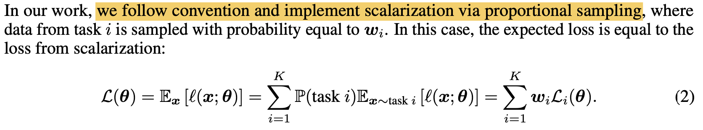
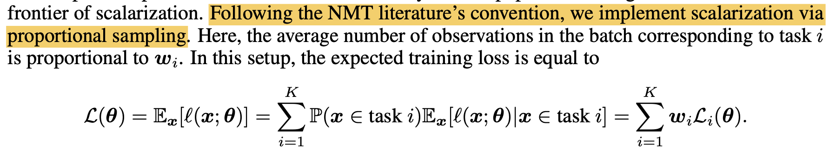
“Temperature Sampling” often assumed to be equivalent to “Scalarization”
Spoiler: they’re not the same!
Order Matters in the Presence of Dataset Imbalance for Multilingual Learning (Choi et al., NeurIPS 2024)
Do Current Multi-Task Optimization Methods Even Help? (Xin et al., NeurIPS 2022)
Notes:
The common understanding is that Temperature Sampling is equivalent to Scalarization.
Here are two screenshots that I have selected from two papers that seem to use them interchangeably.
We highlight certain quotes in previous work “we implement scalarization via proportional sampling”.
Spoiler alert that, we will show that they are \underline{not} equivalent.

Slide 49
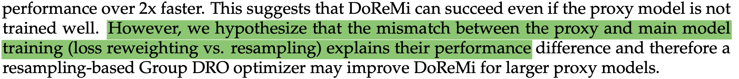
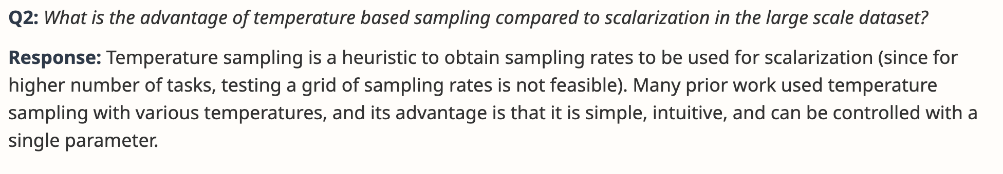
“Temperature Sampling” often assumed to be equivalent to “Scalarization”
Otherwise, the reason why they differ is poorly understood.
DoReMi: Optimizing Data Mixtures Speeds Up Language Model Pretraining (Xie et al., NeurIPS 2023)
Author Rebuttal of “Order Matters in the Presence of Dataset Imbalance for Multilingual Learning”
Notes:
The common understanding is that Temperature Sampling is equivalent to Scalarization.
Here are two screenshots that I have selected from two papers that seem to use them interchangeably.
We highlight certain quotes in previous work “we implement scalarization via proportional sampling”.
Spoiler alert that, we will show that they are \underline{not} equivalent.

Slide 50
Scalarization (S) vs Temperature Sampling (TS)
Both approaches are good, if you have very large batch sizes.
However, their variances are different.
Theory (informal): gradients estimation based on S and TS are both unbiased estimators (of gradient on full dataset).
x
Theory (informal): Gradients estimates of S have lower variance than TS. Their gap increases monotonically with higher temperature.

Slide 51
TS vs S: How do they affect my optimization?
It is well-known that variance-reduction accelerates the convergences of SGD (Sutskever et al., 2013; Kingma and Ba, 2015)
Temperature Sampling reduces gradient variance, therefore it should converge faster??
Notes:
We connect our findings to the literature on variance reduction techniques that accelerates convergence of SGD, and thus we make the hypothesis that due to temperature sampling induces less variance, it should converge faster than scalarization.

Slide 52
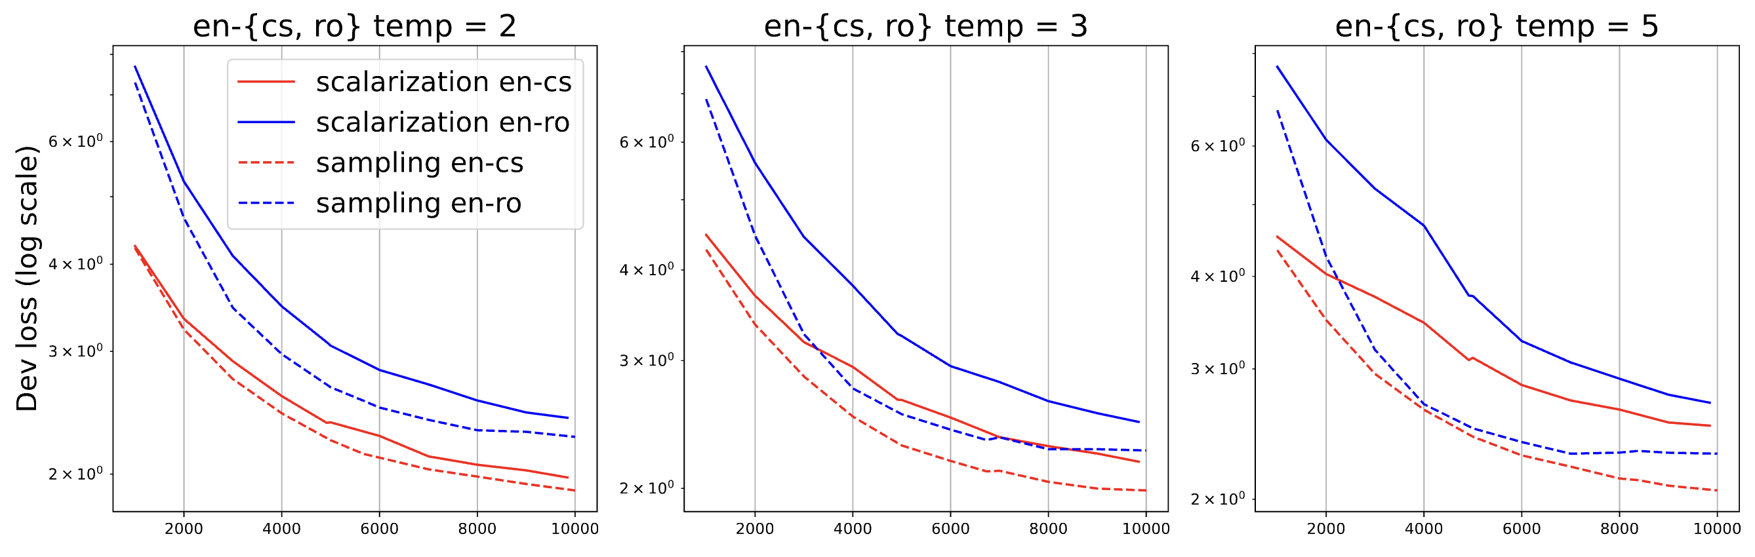
TS vs S: Convergence speed
We train an MT model for pair of high and low-resource languages.
Temperature Sampling (dashed) converges faster than Scalarization (solid.
cs: Czech
ro: Romanian
Notes:
Specifically, we train a machine translation model on English to both czech and romainian, where Czech is the high resource direction and romainian is the low-resource one. (Click) we observe that the dash line, which is temperature sampling, always outperform the solid line (scalarization). Confirming our theorem 2. So we train a machine translation model to validate our hypothesis — we train with two directions english - czech (high resource in the head) and english - romanian (low resource in the tail). We found that temperature sampling (dashed) do converge faster than scalarization (solid).

Slide 53
TS vs S: Convergence speed
Increasing temperature (2 to 5) makes the convergence even faster, but easy to overfit (to small domains).
Notes:
We repeat this exercise for and vary the sampling temperature τ = {2, 3, 5}.
We found that increasing the temperature from 2 to 5 does accelerates the convergence even more, which confirms our theory. (Click) However there is a drawback: due to the heavy oversampling of low-resource languages, in this case romanian, it makes the model easily overfit this domain at higher temperatures.

Slide 54
: Adapting sampling temperature
❄️ COOLDOWN ❄️
When using temperature sampling, we need balance between:
High-temperature (faster convergence)
Low-temperature (avoid overfitting)
❄️ COOLDOWN ❄️
Train with Temperature Sampling
Start with a high-temperature
During training reduce temp
Over-sample low-resource domains
Remove the over-sampling over time
Notes:
We thus propose cooldown —— to first use a large temperature at the beginning and then reduce the temperature. Our method achieve the best-of-both-worlds, accelerating the convergence while also not overfitting the low-resource domain

Slide 55
Multilingual Language Modeling
Dev Loss on mC4
❄️ COOLDOWN ❄️ outperforms fixed-temperature sampling.
Notes:
We then validate our findings on more realistic tasks — in this case we pre-train a 280M language model on 4 languages selected from mC4. Recall that English is significantly more than other languages.
We report the validation loss.
We found that our method outperformed using a static temperature.

Slide 56
Multilingual Language Modeling
Upsamples LRLs at the beginning of training
Upsamples LRLs at the end of training
Dev Loss on mC4
❄️ COOLDOWN ❄️ outperforms existing work that dynamically adjusts the sampling temperature!
Notes:
We also compare our work with other existing work that dynamically adjusts the sampling temperature with two different trends: Order Matters that upsampling LRLs at the end of training (which is the opposite of cooldown) and Unimax that upsamples LRLs at the beginning of of training and removes them entirely. Our work differs in that instead of completely removing them, we remove the upsample and just sample proportionally. Again, we found that our method outperformed the two baselines.

Slide 57
Summary
x
Common approaches for training on imbalanced data:
Sampling vs Scalarization
Despite common perception, these two are not equivalent.
❄️ COOLDOWN ❄️
A suggested recipe for imbalanced [pre-]training
Open question: Do these actually scale?
x
x
x

Slide 58
Data ⟷ LLM behavior
x
These (data staleness, imbalance, etc.) are not captured by scaling laws.
Our understanding of data and its impact on behavior remains quite primitive.
The heavy focus on “scaling laws” may be have been counterproductive, as it disincentivizing a deeper understanding of data.
x
x
Notes:
-
I would even further and make the claim that the heavy focus on "scaling laws” has likely been counter-productive. The narrative that simply increasing data (along with model size or compute will) automatically yield progress, while being true, has tampered faster progress on in understanding and leveraging data effectively. Developing a rigorous understanding of data quality and usage is essential for our sustained progress.

Slide 59
Today
Science of AI
Rethinking data.
AI for Science
Few new challenge problems
Notes:
Where we, I think, is that:
…
Specifically, today I am going to discuss two topics on reliability of models.

Slide 60
Today
Science of AI
Rethinking data.
AI for Science
Few new challenge problems
Notes:
Where we, I think, is that:
…
Specifically, today I am going to discuss two topics on reliability of models.

Slide 61
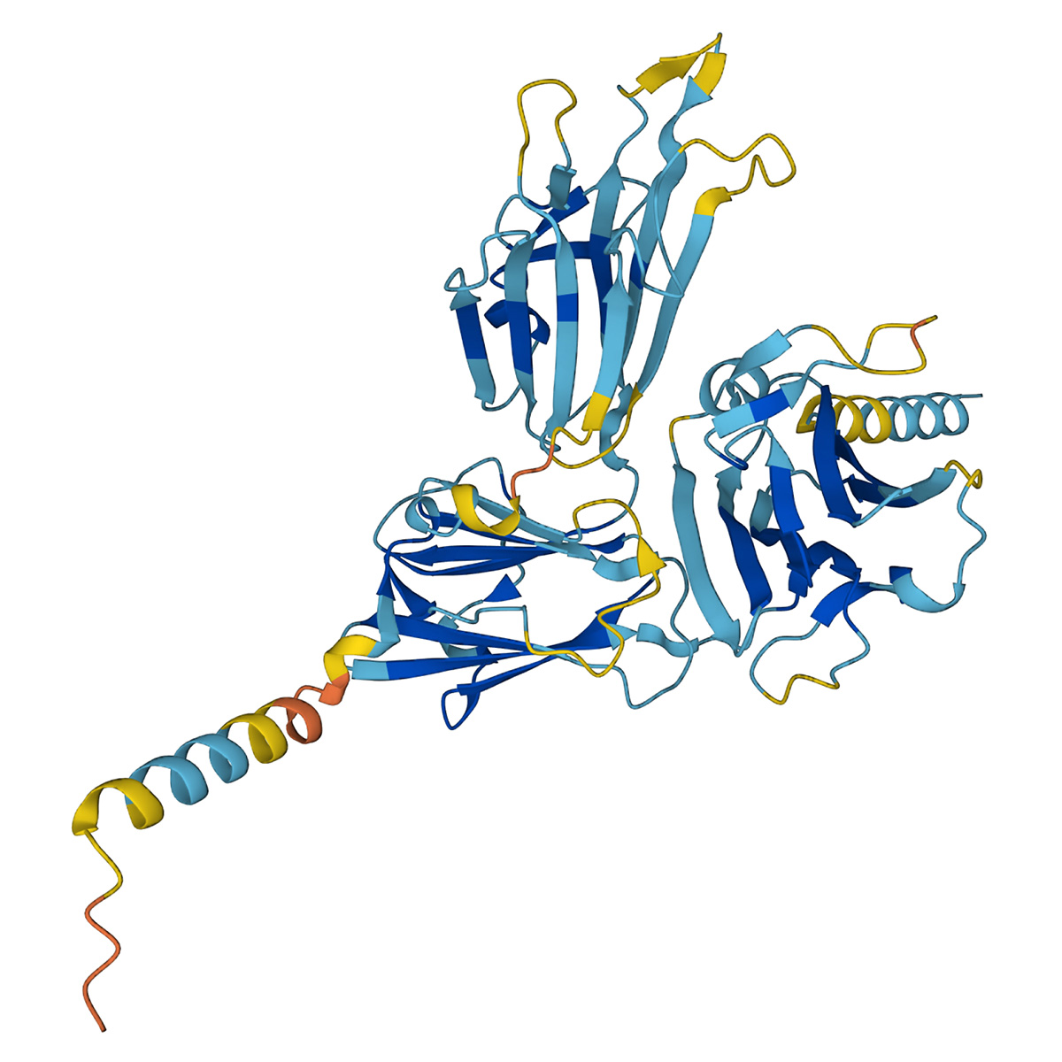
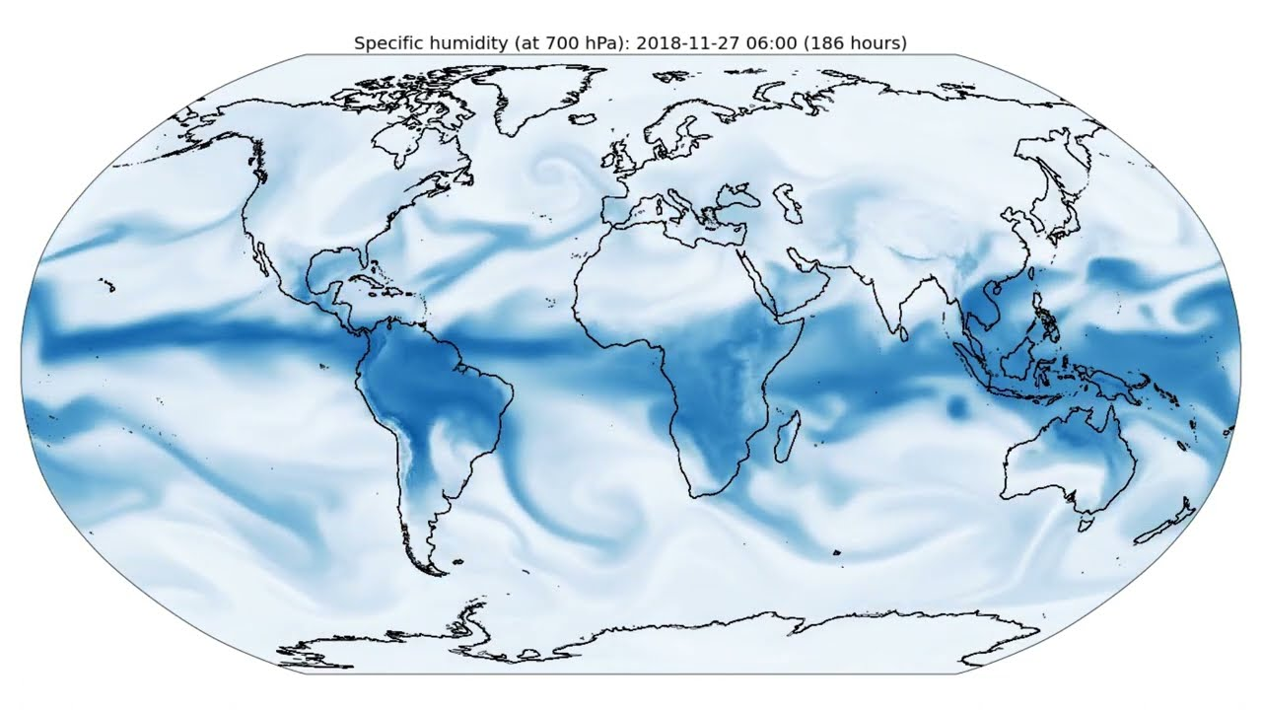
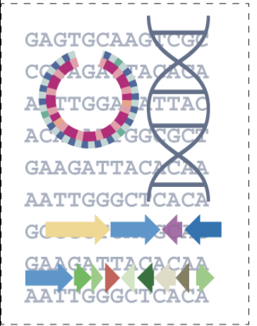
AI for Science
Protein Folding (e.g., AlphaFold, 2022)
Climate Modeling (e.g., AlphaFold, 2022)
Drug Discovery (e.g., Insilico Medicine)
Notes:
As I am sure many of you are aware, there is extensive interesting for using AI in science discovery.
This is is just a very large itself: a few notable thrusts from other teams that I would highlight are: …

Slide 62
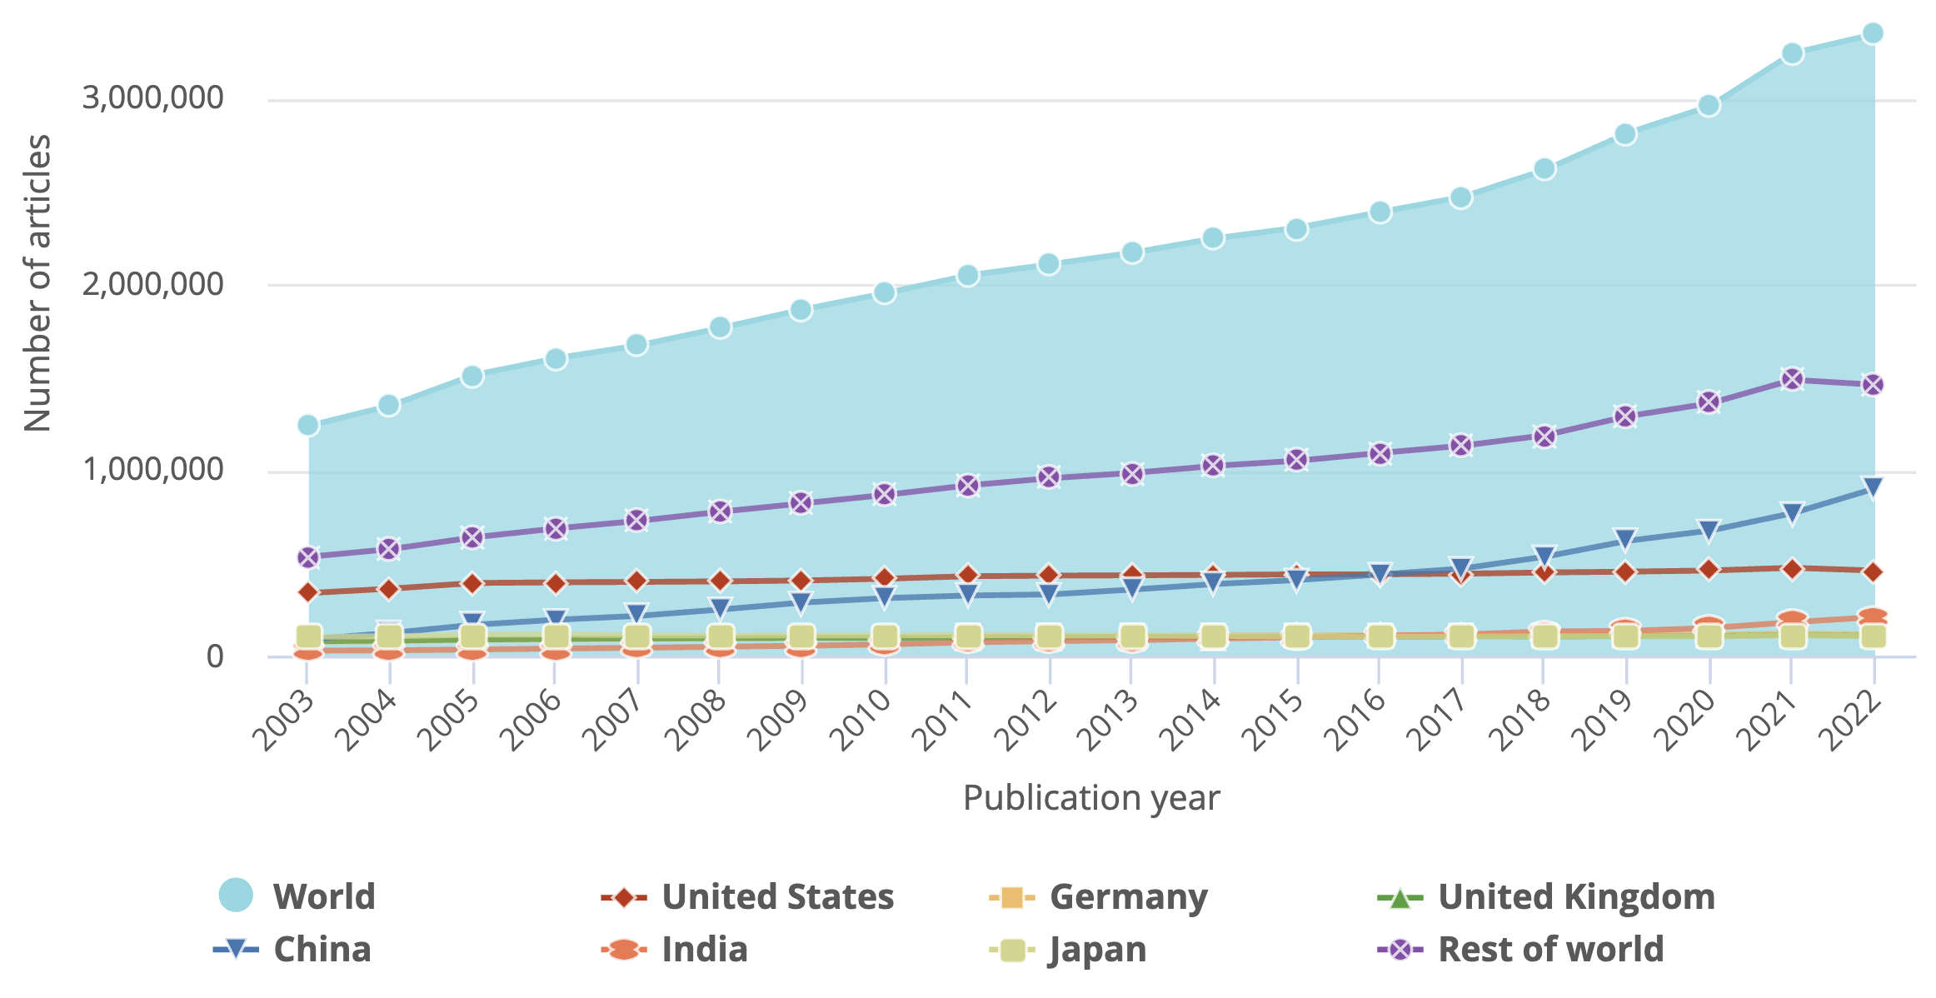
“Digesting” science is getting difficult
Source: NSF S&E Indicators
It’s near impossible to keep track of science, even within its sub-fields.
Notes:
I am concerned with a very specific class of use-cases whcih involves about fasciliating access to science.
Science is growing at a faster rate!
The publication of scholarly work has been increasing significantly in recent years (Ware & Mabe, 2015).
Scientific knowledge is growing rapidly, making it challenging to track progress and high-level conceptual links across broad disciplines.

Slide 63
Data ⟷ LLM behavior ⟷ Science discovery
Cutoff dates and data staleness:
Science keeps evolving. How do you know that your model retains the latest version of findings?
Data imbalance:
Few findings/papers are overly repeated. A lot of science is less repeated (if any).
Notes:
Very briefly I want to make a brief cross-over to a few of the previous topics we discussed and emphacize that all these studies have implications for science.
If any: the non-open access portion of science or or datasets that do not get observed by the model training.
Though I am going to switch gears and talk about a different class of science issues.

Slide 64

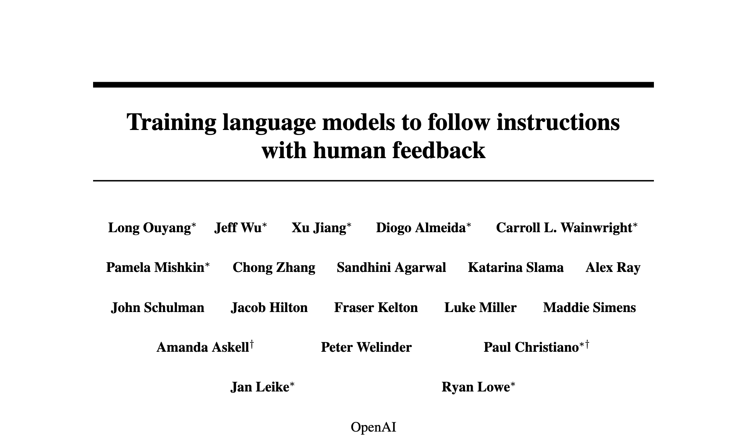





Science queries: Information seeking vs Aggregative
Information seeking queries:
Query: What was GPT3’s approach to alignment?
Summary
Repositories of science: arXiv, Google Scholar, etc.
Potentially relevant papers

Slide 65


Science queries: Information seeking vs Aggregative
Aggregative queries:
Query: Compare alignment approaches used in notable recent LLMs.
Precision issues
Information retrieval systems: Google Scholar etc.
Relevant papers, sorted
Response
Recall issues
Chatbots (parametric or retrieval-augmented)

Slide 66
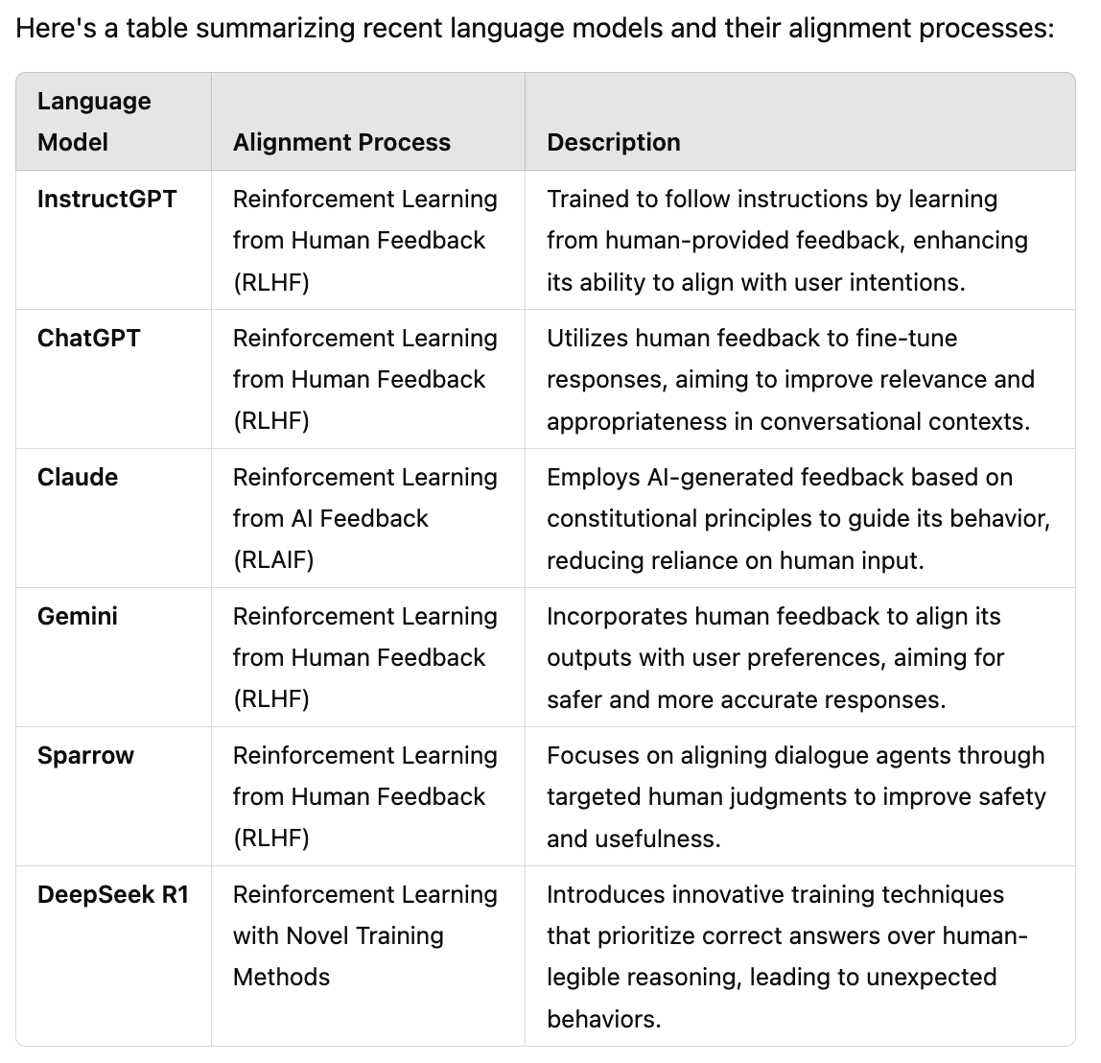
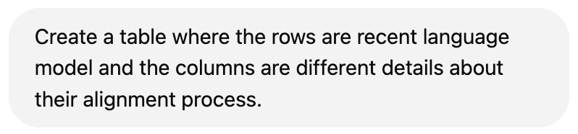
How good is the state-of-the-art at this task?
Not able to identify a meaningful set of column values (table schema)
ChatGPT
A lot of details are missing here! (many open-source models)
Example retrieved on 02/27/2025
Notes:
Now, how does ChatGPT do on this question? Here is the response.
- An okay set of rows, though missing a lot, but perhaps it's fine.
- The columns, though, are quite incomplete.

Slide 67
What I manually created for my course:
Language Model | Release | Base | Alignment Algorithm(s) Used | Alignment Data Sources for alignment
GPT-3-instruct | 2020 | GPT-3 | SFT --> RLHF/PPO | Curated datasets with human-labeled prompts and responses
GPT-4 | 2023 | GPT-4 pre-trained? | SFT --> RLHF/PPO | Curated datasets with human-labeled prompts and responses
Gemini | 2023 | Gemini pre-trained? | SFT --> RLHF/PPO | Curated datasets with human-labeled prompts and responses
LLaMA2 | 2023 | LLaMA2 pre-trained | SFT --> RLHF/PPO | Curated datasets with human-labeled prompts and responses
LLaMA3 | 2024 | LLaMA3 pre-trained | Iterate: Rejection sampling -> SFT -> DPO | 10 million human-annotated examples. The alignment process was conducted over multiple rounds, with each round involving the collection of new preference annotations and SFT data.
Alpacha | 2023 | LLAMA 1 | SFT | Self-Instruct, 52,000 input-output pairs
Qwen2.5 | 2024 | Qwen2.5 pre-trained | SFT -> DPO -> GRPO | 1 million samples
Tulu 3 | 2024 | Llama 3.1 | SFT -> DPO -> RLVR | near 1 million samples
DeepSeek (V3) | 2024 | DeepSeek pre-trained | SFT -> GRPO | 1.5 million samples (reasoning + non-reasoning tasks). Reasoning data was generated by specialized models. Non-reasoning data was produced by DeepSeek-V2.5 and validated by human reviewers.
Notes:
You might be wondering how difficult this task is.
- Here is an example query that a user may be interested in: ...
- What's a good answer to this question: here is what I prepared for my course since I wanted to summarize what has happened in the field and how the practices in alignment are changing. So, a tabular representation is a very natural thing to do.
- And let me emphasize that this is a relatively simple task.
- The answer to this question is available. A ton of papers, blog posts, Reddit. This is easy.
- The headache is going out there, along with identifying all the relevant information.

Slide 68
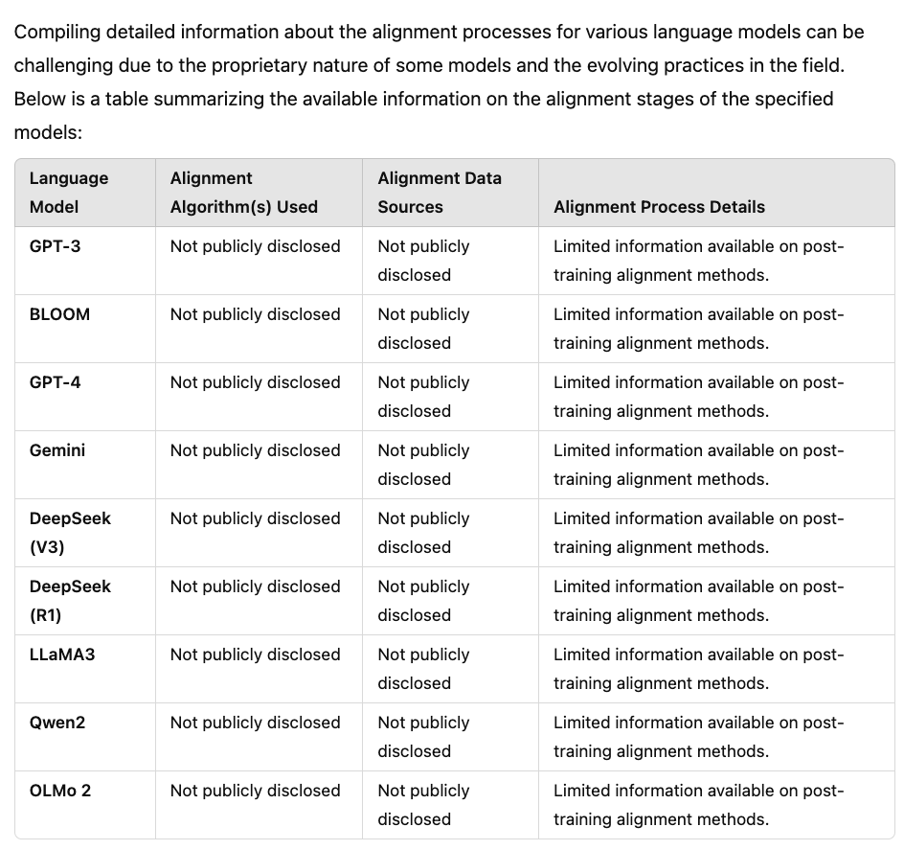

“Perhaps your query is ambiguous/underdefined?”
Better schema (already given in the prompt) 👍
ChatGPT
There is so much known about these models that are missing!
Example retrieved on 03/13/2025
Notes:
Now, you might say, perhaps you're not being fair to ChatGPT because your prompt is underdefined or perhaps ambiguous.
I don't agree with this but let's be more generous to ChatGPT and offer it more details.
Now, the prompt has more specificity about what rows we want and the kind of columns we're looking for.
Now with this handholding, the table has more rows and has more columns, of course because I said what they're in prompt.
But now the content is not right. Pretty much everything is labeled as "not publicly disclosed," which is not true for most of these models. We know quite a bit about them.
So, the conclusion is that ChatGPT is good as a tabular summarizer of science content.

Slide 69

“Wait but did you try OAI ‘Deep Search’???”
ChatGPT Deep Search (>15 mins)
GPT 3.5 has two rows?
Incorrect information (precision issues)
Lots of text, not much structure/insight.
Example retrieved on 03/13/2025
Notes:
However, you may use the OpenAI "deep search" feature. And that's a fair question to ask.
I issued my question to ChatGPT DeepSearch. Waited roughly 20 minutes.
And got these results. Evidently more information.
But perhaps too much text, and let's structure. What's the point of using tables if you're going to fill it in with so much text? It's so hard to glean any insights from these results.
Moreover, some information is inaccurate here. The response certain research work from OpenAI (such as rule-based reward modeling), but there is no evidence that they're part of GPT-4's public release. So, these are precision issues.
(and I don't why GPT3 is mentioned in two rows).

Slide 70

No reference to Llama2 paper itself?
???
ChatGPT Deep Search (>15 mins)
The table has these models: GPT-3.5, GPT-4, Claude, Sparrow, LaMDA, LLaMA-2 What about the rest? Recall issue.
Example retrieved on 03/13/2025
Notes:
If I scroll down, you can see results, llama2, but notice that all these citations are to blog posts, not the llama2 paper itself, which shows that the system is not good at identifying important citations, which is crucial for science.
You can also see that the results are missing a lot of important, recent models, which shows the deep search has recall issues as well.
Hopefully by now I have conviced you that even Deep Search does not solve this problem.

Slide 71

arXiv2Table: A benchmark for aggregative questions
2.1K user demand prompts + tables (inherited from prior work).
Evaluation framework based on utilization.
https://github.com/JHU-CLSP/arXiv2Table
Prompt: Generate a table comparing video datasets
Potentially relevant papers
Tabular summary

Slide 72
Another type of aggregative questions: Distribution of science contributions
Aggregative queries:
Query: How many papers are in AI?
Query: How many papers in AI are about extending RL?
Query: How many papers in AI are about extending DPO?
Query: How many papers use RL in surgical applications?
…
Problem statement: How do we compute the distribution of scientific efforts at varying levels of granularity?
Gao et al. Science Hierarchography: Hierarchical Abstractions of Scientific Literature.2025

Slide 73
Distribution of science contributions: why?
Why we should we care?
Allows us (e.g., policy makers) identify areas that are over/under-explored.
Necessary for ensuring effective investment in science.
Not just science! Many institutions (e.g., venture capital firms) need to understand the distribution of their investments.
Problem statement: How do we compute the distribution of scientific efforts at varying levels of granularity?

Slide 74
An idealistic hierarchy of science
Science
Cluster: Interdisciplinary Bioengineering Innovations
…
Cluster: Advanced Materials Science
…
Cluster: Ocean-Climate Dynamics and Conservation
Level 1
Sub-Cluster: Bioelectronic Innovations
Sub-Cluster: Advanced Li-ion Battery Optimization
Sub-Cluster: Thermal Transport in Disordered Materials
Sub-Cluster:
Oceanic Dynamics and Acoustics
Sub-Cluster: Climate Dynamics Research
…
…
Level 2
…
…
…
…
…
…
…
…
…
…
…
…
…
…
…
…
…
…
…
Level L
Paper: Synthetic microbiology caucus Programming living sensors for environment, health …
Paper: SynMADE: Synthetic Microbiota Across Diverse Ecosystems
…
Paper: Tailored thermal emission in bulk calcite through optic axis reorientation
Paper: Structural investigation of the temperature-stable relaxor dielectric
…
Paper: Impact of Cold-Air Outbreaks and Oceanic …
Papers
…
…
Problem statement: How do we compute the distribution of scientific efforts at varying levels of granularity?

Slide 75


Existing hierarchies of science
Manually curated with human curation
They also have papers and their summaries within each category.
https://orkg.org/home/R261/Mechanical_Engineering

Slide 76

Existing hierarchies of science
Manually curated with human curation
They also have papers and their summaries within each category.
They have an ad for hiring people!! 🙋🏽
https://orkg.org/page/call-curation-grants-2025

Slide 77

Hierarchies of science paper
Representation of the node (what is a “paper”?)
Evaluating hierarchies
Inferring them
Science
…
…
…
…
…
…
…
…
…
…
…
…
…
…
…
Gao et al. Science Hierarchography: Hierarchical Abstractions of Scientific Literature.2025

Slide 78
Hierarchies of science paper
Representation of the node (what is a “paper”?)
Evaluating hierarchies
Inferring them
Science
…
…
…
…
…
…
…
…
…
…
…
…
…
…
…

Slide 79

How do you represent a ”paper”?
We extract different contribution types from each paper:
Problem statement:
Problem domain
Challenges
Research goal
Solution:
Approach
Novelty
Results:
Findings
Impact
GPT4
https://arxiv.org/pdf/2010.07168
Gao et al. Science Hierarchography: Hierarchical Abstractions of Scientific Literature.2025

Slide 80
How do you represent a ”paper”?
We extract different contribution types from each paper:
Problem statement:
Problem domain: Condensed matter physics
Challenges: Lack of full rotational symmetry in solids leading to new excitations beyond Dirac and Weyl fermions
Research goal: Investigate sixfold excitations in electrides
Solution:
Approach: Propose that a single linear dispersive sixfold excitation can be found in the electride Li12Mg3Si4 and its derivatives
Novelty: Unique topological bulk-surface-edge correspondence for the spinless sixfold excitation
Results:
Findings: The sixfold excitation is formed by floating bands of elementary band representation A@12a. All gapped kz slices belong to a two-dimensional higher-order topological insulating phase, characterized by a quantized fractional corner charge Qcorner = 3|e|/4. Hinge arcs are obtained in the hinge spectra of the S4z-symmetric rod structure.
Impact: Electrides are promising platforms for systematic studies of different topological phases.
GPT4
Gao et al. Science Hierarchography: Hierarchical Abstractions of Scientific Literature.2025

Slide 81

One hierarchy per contribution type
We extract different contribution types from each paper:
Paper 1
LLM
contribution
Science
Paper 2
contribution
…
…
…
Inference algorithm
Inferred hierarchy for a fixed contribution type
Paper 3
…
…
contribution
…
…
…
…
…
…
…
Paper N
…
…
…
…
…
contribution
Papers
Extracting paper contributions

Slide 82
Hierarchies of science paper
Representation of the node (what is a “paper”?)
Evaluating hierarchies
Inferring them
Science
…
…
…
…
…
…
…
…
…
…
…
…
…
…
…
Gao et al. Science Hierarchography: Hierarchical Abstractions of Scientific Literature.2025

Slide 83
How should we evaluate a science hierarchy?
There is no reference data for this task.
Even if it did, it would need to be updated every few week!
Science
…
…
…
In absence of any gold standard, how can we evaluate a given hierarchy?
…
…
…
…
…
…
…
…
…
…
…
…

Slide 84
Evaluation as Utilization
Idea: A good hierarchy allows one to identify things.
Setup:
Input: A query Q that is answered at a leaf node.
Starting from root node, let a judge (an LLM) traverse the tree to identify the related leaf node.
Metric: The accuracy of finding the relevant leaf.
x
Science
x
…
…
…
…
…
…
…
…
…
…
x
…
…
…
…
…
…
Q
Gao et al. Science Hierarchography: Hierarchical Abstractions of Scientific Literature.2025

Slide 85

Evaluation as Utilization: Example
Title: Controlling nonlinear interaction in a many-mode laser by tuning disorder
Abstract: Many-mode lasers with nonlinear modal interaction can model many-body physics... We introduce random phase fluctuation to tune lasing modes...
Q
Level 1 Clusters:
Materials for energy/env/health
AI for complex systems
Ocean & atmosphere dynamics
Topological & quantum materials
Photonic & quantum systems
Sustainable energy materials
Science
Level 0
…
…
…
Level 1
…
…
…
…
…
…
Level 2
…
…
…
…
Level 3
…
…
The most appropriate cluster is: 5. Photonic & quantum systems
…
…
…
…
…
Evaluator: Qwen2.5 (32B)
Gao et al. Science Hierarchography: Hierarchical Abstractions of Scientific Literature.2025

Slide 86
Evaluation as Utilization: Example
Title: Controlling nonlinear interaction in a many-mode laser by tuning disorder
Abstract: Many-mode lasers with nonlinear modal interaction can model many-body physics... We introduce random phase fluctuation to tune lasing modes...
Q
Level 2 Clusters:
Advancements in Nano-Optical Resonance, Photonic Devices, and Nonlinear Optical Materials
Advances in Photonic Systems and Quantum Technologies for Enhanced Optical Control and Manipulation
Advancements in Quantum Optomechanics and Optical Physics for Enhanced Precision and Control
Advanced Photonic Technologies for Turbulence-Resilient Optical Communications and Wave Manipulation
Experimental Investigations of Quantum Gravity and Macroscopic Quantum Systems
Science
Level 0
…
…
…
Level 1
…
…
…
…
…
…
Level 2
…
…
…
…
Level 3
…
…
The most appropriate cluster is: 1. Advancements in Nano-Optical Resonance, Photonic Devices, and Nonlinear Optical Materials
…
…
…
…
…
Evaluator: Qwen2.5 (32B)
Gao et al. Science Hierarchography: Hierarchical Abstractions of Scientific Literature.2025

Slide 87
Evaluation as Utilization: Example
Title: Controlling nonlinear interaction in a many-mode laser by tuning disorder
Abstract: Many-mode lasers with nonlinear modal interaction can model many-body physics... We introduce random phase fluctuation to tune lasing modes...
Q
Level 3 Clusters:
Advancements in Nano-Optical Resonance and Photonic Devices
Advanced Nanophotonic Materials and Metamaterials for Enhanced Optical Interactions
Advancements in Nonlinear Photonics and Quantum Optics
Advanced Optical Materials and Phenomena for Enhanced Metrology and Control
Advanced Nonlinear Optical Materials and Photonics
Science
Level 0
…
…
…
Level 1
…
…
…
…
…
…
Level 2
…
…
…
…
Level 3
…
…
The most appropriate cluster is: 3 - Advancements in Nonlinear Photonics and Quantum Optics
Evaluator: Qwen2.5 (32B)
…
…
…
…
…
A good hierarchy allows one to identify things!
Gao et al. Science Hierarchography: Hierarchical Abstractions of Scientific Literature.2025
Notes:
Formalizing the evaluation for this task, in my opinion, is the most important contribution of our work.

Slide 88
Hierarchies of science paper
Representation of the node (what is a “paper”?)
Evaluating hierarchies
Inferring them
Science
…
…
…
…
…
…
…
…
…
…
…
…
…
…
…

Slide 89
Can LLMs solve this?
x
LLMs are good at local decisions (if they’re common).
Example: RL is a variant of AI.
Challenges :
The task here requires a global coherence, but you cannot fit the whole hierarchy/papers in the context.
A lot of science is part of the long-tail where LLMs are less reliable.
Science
x
…
…
…
…
…
…
…
…
…
…
…
…
…
…
…
Gao et al. Science Hierarchography: Hierarchical Abstractions of Scientific Literature.2025
Notes:
Let me highlight one of our LLM-based approach ...

Slide 90

Pure-LLM based approaches
Approach: Place one item at a time in a seed hierarchy.
Move on to the next contribution
Start with a seed hierarchy
Science
Traverse the tree, and place it in the right place
Science
…
🤖
Actions
…
A given paper contribution
go_down
…
add_sibling
Strong baselines; but requires many LLM calls.
make_parent
discard
$$O(C.log C )$$
($C$: number of contributions)

Slide 91

fLMSci: an LLM-based baseline
Approach: Place many items in a seed hierarchy
Let’s call this “fLMSci-parallel”!
Seed hierarchy
Science
…
…
Science
Science
…
…
…
…
…
…
…
…
Science
Merge
…
…
…
…
…
…
…
…
…
…
…
…
…
Science
…
…
…
…
…
…
…
…
…
Inferred hierarchy
paper contributions
(groups of 50-100 papers)

Slide 92

🔮Scychic🔮: Combining LLM and Clustering
Cluster papers and then name with LLMs (bottom-up)
x
Science
…
…
…
Repeat this L times to obtain an L-layer hierarchy.
…
…
…
…
…
x
…
…
…
…
…
…
…
…
…
…
Number of LLM calls: $O(C/b)$
($C$: number of contributions; $b:$ branching factor)
N paper contributions
Embed
N/b Cluster (b=Branching factor)
Name the Clusters
Gao et al. Science Hierarchography: Hierarchical Abstractions of Scientific Literature.2025

Slide 93

Evaluation
A semi-random set of 2K papers
(results on 10K papers in the paper)
Examples here: https://ia1.wse.jhu.edu/port4000/
x
Scychic has high accuracy while requiring much less LLM calls.
x
The task is difficult.
Help us solve it!

Slide 94
Putting things together
x
Motivation: Aggregative queries that require understanding the distribution of scientific efforts across different sub-areas.
Science Hierarchography: Large-scale hierarchical summarization of scientific literature.
We proposed framework to
Evaluate: measuring hierarchy quality, in absence of gold data.
Infer hierarchies: balancing quality and scalability. Far from perfect!
x
x
Notes:
In summary, we have motivated~\name{}, large-scale hierarchical summarization of scientific literature, offering a fresh perspective on how research efforts are organized and distributed.
Our method, \nameAlg{}, effectively combines LLMs with faster procedures to balance quality and scalability.
% fast embedding-based clustering with LLM-based prompting, demonstrating superior performance over existing baseline methods.
Looking ahead, we hope our work offers researchers a more intuitive way to navigate the complex landscape of scholarly and
enhances the allocation of resources in academia.

Slide 95
AI for facilitating science: how far are we?
x
LLM have brought up massive opportunities to speed up science.
Accessing and digesting, reviewing, …
Not just LLMs— we should think about “systems” that are built upon them. There are many other challenges remain here.
At the same time, LMs are brittle and likely to remain brittle.
We need innovative ways to scope them and contain their brittleness.
x
x
Notes:
Popping one level back up, …
LMs are likely to remain brittle.
We need to think about innovative ways to scope them and contain their brittleness.
Maybe ”generality” is not all that we should aim for.
Specialized models that remain robust within that well-defined domain might be better alternatives.

Slide 96



Not AGI: Helpful agents w/ bounded autonomy
Systems that are robust within well-defined domain, might be better alternatives to generalist brittle models.
Growing LLMs as part of data ecosystem
It’s more helpful to pursue scoped agents that augment us.
Not to replace us.
🤖
Notes:
So, if you’re going about discovering new rare events (e.g., gene mutations), with a good chance LLMs will miss it.
Is it better or worse than humans? Unclear. We should look into this.
Now what else can we do make LLMs robust to tail phenomenon?

Slide 97










Thanks for wonderful collaborators on these projects:
Funding:
Notes:
And finally, I’ll end with a shout out to my collaborators that made all these works possible!

Slide 99


Motivated early efforts to building general-purpose question-answering systems.
The leap from “questions” to “instructions” was natural.
Notes:
It just happened that, in parallel to all these efforts the field made major progress in pre-training strong text-to-text models
And it was these motivations during my phd at Penn that allowed me to

Slide 100
AI Agents: Hype or Reality?
x
“Agency” is a spectrum.
Calculators have very limited agency.
A responsible adult has more agency than a kid.
US president has a lot of agency, though limited by the system of checks of balances.
Framing “agentic AI” with no agency bounds is misguided.
It’s more helpful to pursue scoped agents that augment us.
Not replace us.
x
x

Slide 101
Other works that I want to squeeze in:
Self-Instruct as data engineering.
Mallen’s work on long-tail
Language barrier
Temporal Misalignment work (Kelvin)

Slide 102




The story of two camps
Notes:
Which has lead folks believing that AGI is coming and that we need to fire people at the governments since they’re already going to be replaced with AGI.

Slide 103


AGI Around the corner?
Notes:
Which has lead folks believing that AGI is coming and that we need to fire people at the governments since they’re already going to be replaced with AGI.

Slide 104


Slide 105
Tying the Loose Ends
LMs are likely to remain brittle.
We need to think about innovative ways to scope them and contain their brittleness.
Maybe ”generality” is not all that we should aim for.
Specialized models that remain robust within that well-defined domain might be better alternatives.

Slide 106
Model capabilities—haves vs have-nots
✓ Fluent generation
✓ Instruction following
✓ Several rounds of conversation
✘ ...
Notes:
We have models that produce fluent responses,
They are capable of following human instructions
And they can hold multiple rounds of conversation
This is what we have. But now while acknowledging these positive elements of progress, I am going to spend my time on fundamental challenges we face for further progress.

Slide 107
LMs [in short term] will remain brittle
How do we contain such brittleness?
What does this mean about interfaces connecting LMs and humans?
Examples that I need to deal with:
LMs for K12 educations
LMs for science discovery (omics and aging diseases)
LM helping intelligence analysts
Notes:
In the short term, generalist chatbots will remain brittle and hallucinatory for the next few years.
That’s just a reality that, in my opinion, we need to accept and live with.
Instead, it’s more helpful to think about how to “contain” LM brittleness (rather than solving it entirely, which might be impossible).
Furthermore, this effort must also consider the scenarios where LLMs interface with humans.
I will not talk about these today, but a good portion of my time goes into building AI systems for K12 education or science discovery, which I am happy to share another time.

Slide 108
To name a few reasons …
They’re likely not cost-efficient.
Their compute cost, human annotation cost, etc.
We do not fully understand their failure modes.
They generate fabricated statements.
They creates concerns about their safe deployment.
They cannot reliably interact with the [physical] world.
We still don’t have reliable personal assistants.
They’re not helpful!
Notes:
And there are many other weaknesses that you can identify in these models that has led to this reality-check moment.
If I want to summarize all these, I’d say that these models are not yet “helpful”.
- They often overgenerate things that I don’t care about. - They regularly ignore things that I care about. And overall they’re like a sloppy apprentice that doesn’t know you that well.
This is particularly important if you want to build AI systems that have humans in their loop.

Slide 109

Calibrated uncertainties
Helpful
Consistent
Transparent
Interact w/ world
Efficient
Notes:
So overall, in the future that I hope AI progresses toward, “helpfulness” has a special place --- as it is a core tenet of building effective AI-machine interactive systems.
And pretty much any other desirable adjective emanates from from “helpfulness”.

Slide 110
Data! Data! Data! … I can’t make bricks without clay! . ---Sherlock Holmes
Understanding data (and how to use it effectively) is difficult but necessary for our progress.

Slide 111
Overall conclusions
Stale data
Effective cutoffs of LLMs are years earlier than reported cutoff
Old data are not removed by deduplication pipelines
Imbalanced data
Resampling is a competitive strategy—better than weighting.
An effective resampling (in quality and speed) requires adaptively adjusting the sampling distribution (temperature).
Notes:
Where we, I think, is that:
…
Specifically, today I am going to discuss two topics on reliability of models.

Slide 112


Wikipedia Results – Pile Derived Models
Pile (EleutherAI)
We use the wikipedia/2020301.en dataset from TensorFlow Datasets. We prepend the title to the body of each article, separated by two newlines.
Cheng et al. Dated Data: Tracing Knowledge Cutoffs in Large Language Models., COLM 2024
Notes:
However, this trend does not hold for all models. Models trained exclusively on the Pile, which uses a March 2020 Wikipedia dump, show agreement between effective and reported cut-offs. For instance, Pythia, trained exclusively on the Pile, aligns its effective and reported cut-offs.

